Slide 1
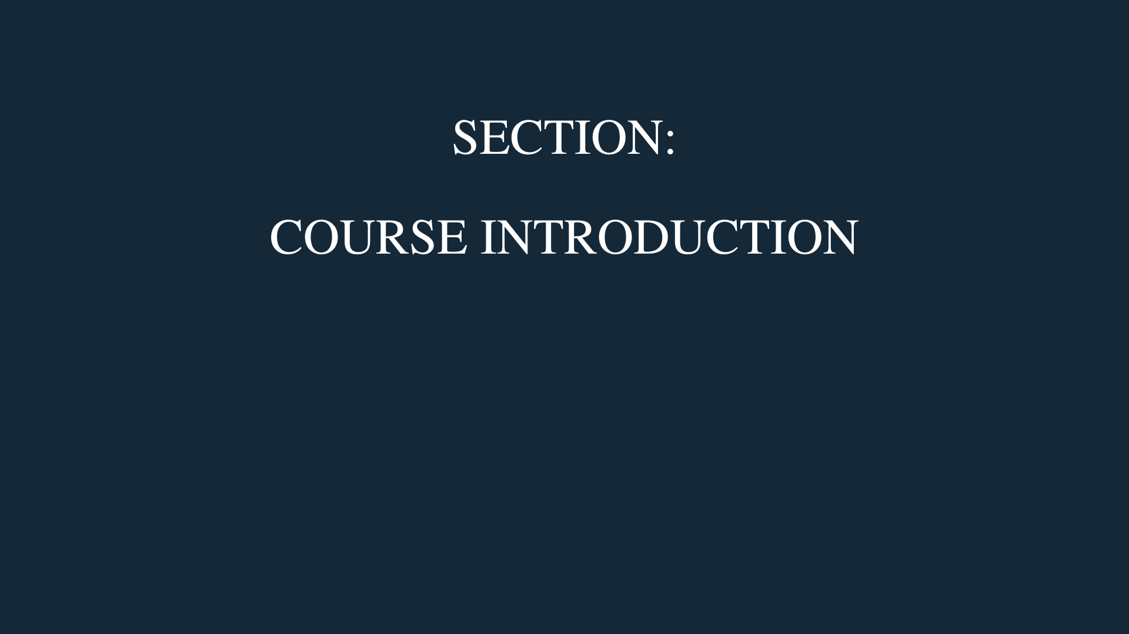

Arno Pretorius

Slide 2

Cloud Computing on AWS:
Ultimate Beginners Course - 2022
By Arno Pretorius

Slide 3
Course overview
Arno Pretorius

Slide 4

Are there any pre-requisites?
There are no pre-requisites for this course, just a desire and motivation to learn
It would be helpful to know a few basic IT concepts, but don’t worry it’s not mandatory for this course
--- This course is for complete beginners ---
Arno Pretorius

Slide 5

What will we learn?
This course is an introductory course to cloud computing
Therefore, we will be learning the basics of cloud computing on the AWS platform
We will cover over 30 + AWS services
The course will focus on a theory-practical based approach
AWS can sometimes be quite challenging, but don’t worry we will tackle everything together!
Arno Pretorius

Slide 6

Estimated cost - using AWS
Most the services that we will be using in AWS will be FREE although, there will be services that may cost a little bit of money
I will give you an estimate of the cost and breakdown the services that cost money
For more information on the free tier, please be sure to check out the link below:
https://aws.amazon.com/free/
Arno Pretorius

Slide 7
Estimated cost - using AWS…
Roughly… $14.17
Route 53 = $12.50 [AWS service]
ECS = $0.04 [AWS service]
Note: Make sure that you delete your resources/instances, after you are done using them!
KMS = $1 [AWS service]
Including… VAT charges (will vary) = $0.63
Arno Pretorius

Slide 8
Thought process
Arno Pretorius

Slide 9

Before we begin…
Arno Pretorius

Slide 10

Structure our thought process
Arno Pretorius

Slide 11

One step at a time…
Arno Pretorius

Slide 12




Focus on progress and not on time
“Today, I created my aws account and learned about IAM.”
“Today, I learned about virtual severs.”
“I’m struggling to understand all these concepts, It’s been 2 weeks already.”
Arno Pretorius

Slide 13
Just a quick note…
Arno Pretorius

Slide 14


A quick note.
Practical / hands-on activity
Arno Pretorius

Slide 15


Another quick note.
Includes a downloadable PDF guide.
Arno Pretorius

Slide 16
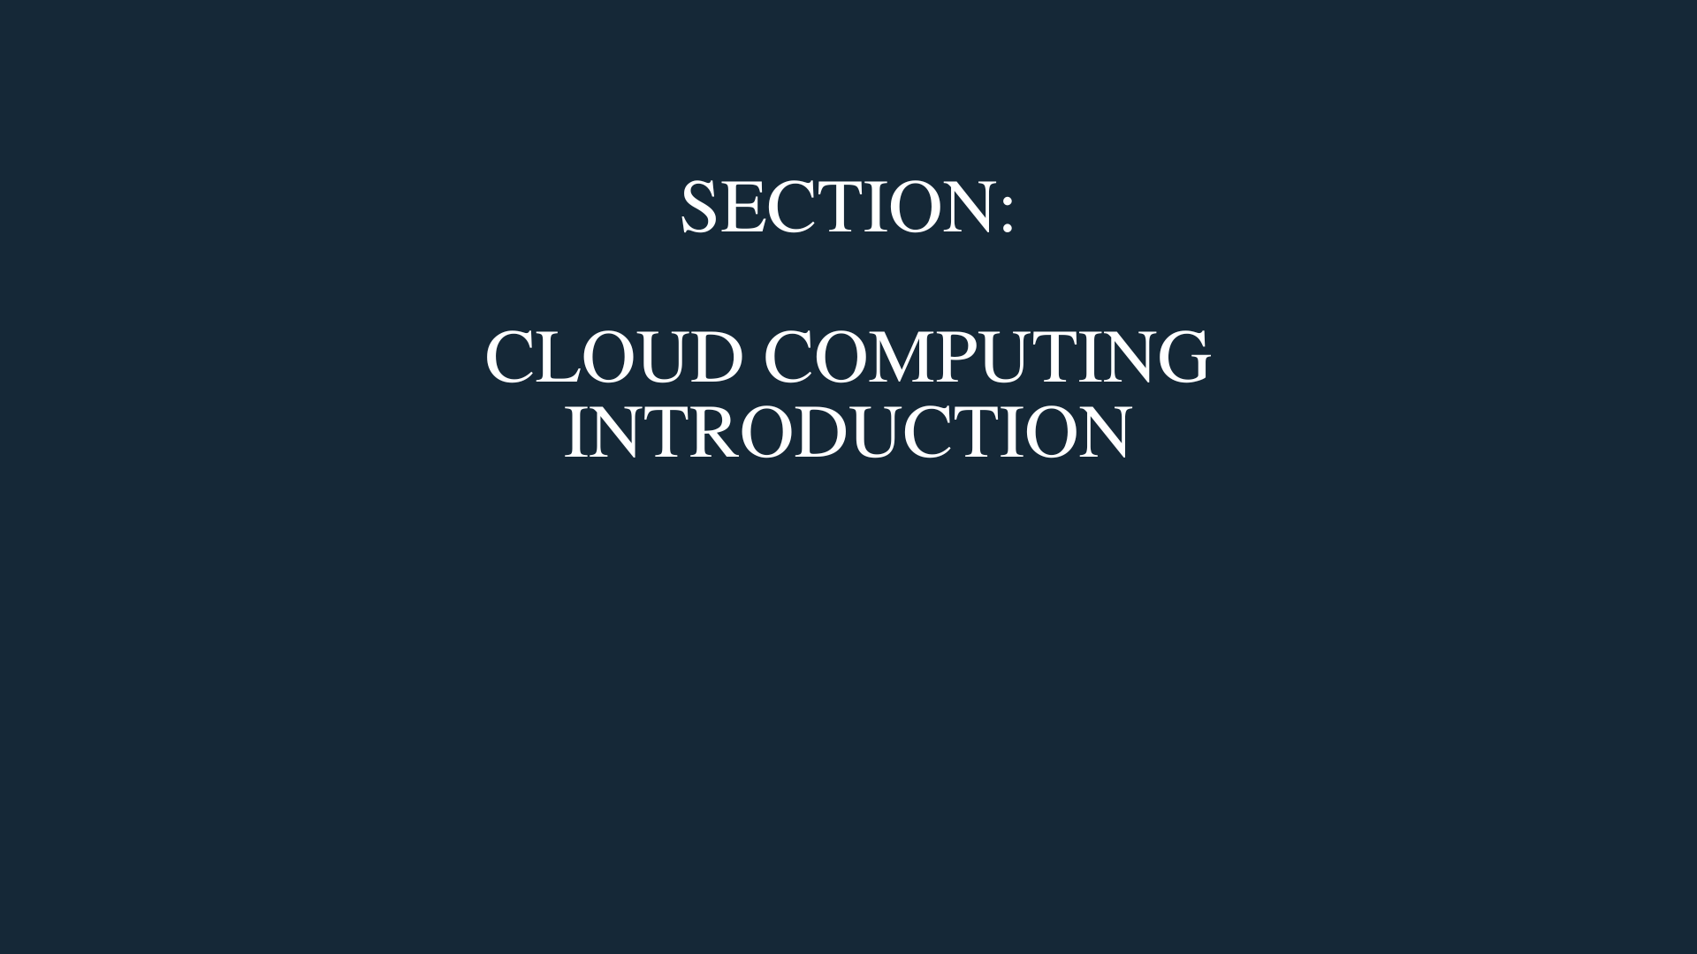
Arno Pretorius

Slide 17
General IT concepts
Arno Pretorius

Slide 18

What is IT?
IT (Information Technology) is the use of computers, storage, networking and other devices to create, store and process data
Arno Pretorius

Slide 19


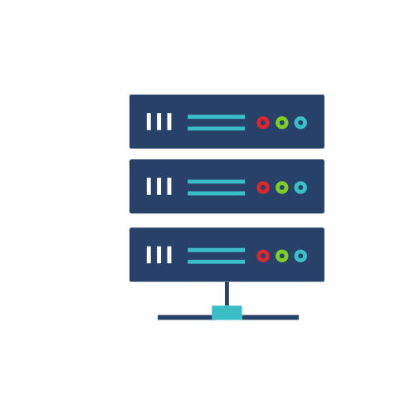

Connecting to a website
Client (user)
Network (Internet)
Server
Arno Pretorius

Slide 20
What is a server?
Simply put, a server is a piece of computer hardware or software that provides resources/services to other computing devices, known as - clients.
Arno Pretorius

Slide 21

Traditional IT: Infrastructure
Store multiple servers In a data center
Store a server in your home
Arno Pretorius

Slide 22

Limitations of traditional IT
Scaling depends on your ability to get more data centers to store your servers
Contingency plan for natural disasters?
Pay for renting the data center and for server maintenance
People need to monitor all the servers in-case of an outage
Need to have air cooling systems
Arno Pretorius

Slide 23


How do we solve this limitation?
Arno Pretorius

Slide 24
Traditional IT: Infrastructure
Store multiple servers in a data center
Arno Pretorius

Slide 25
Cloud-based: Infrastructure
Store multiple servers in the cloud
Arno Pretorius

Slide 26
An introduction to cloud computing
Arno Pretorius

Slide 27

What is cloud computing?
Cloud computing is the on-demand delivery of various computer services: Including compute, storage, databases, and networking
Perform cloud computing through a cloud service provider: I.e., AWS, Azure or GCP
You can access as many computing resources as you need, almost instantaneously
Offers a pay-as-you-go pricing model (on-demand)
You can provision which computing resource you require, with any size or type
Arno Pretorius

Slide 28

The main cloud computing services
Compute
Storage
Database
Networking
Arno Pretorius

Slide 29





Compute
Compute refers to the processing power of a machine
Arno Pretorius

Slide 30
Compute
Compute refers to the processing power of a machine
Arno Pretorius

Slide 31







Storage
Storage is used to save and store data in a data storage device
Or we can use the cloud to store data in cloud storage
Arno Pretorius

Slide 32


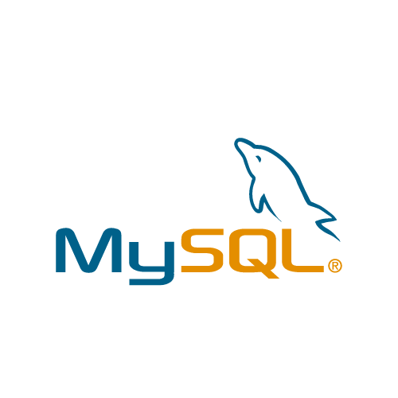

Database
A database is an organized collection of data that is accessed and stored electronically
We store structured data (data arranged in rows and columns) in a database
Typical examples include:
PostgreSQL
MySQL
Oracle
Arno Pretorius

Slide 33




Networking
Networking can be defined as a service that provides connectivity among many kinds of services
Arno Pretorius

Slide 34
What is cloud computing?
Cloud computing is the on-demand delivery of various computer services: Including compute, storage, databases, and networking
Arno Pretorius

Slide 35
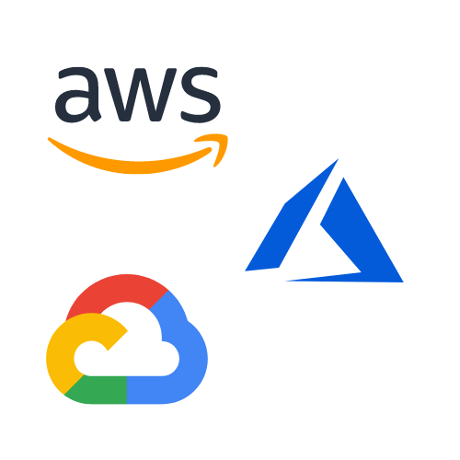
Cloud service providers
Amazon Web Services (AWS)
Google Cloud Platform (GCP)
Microsoft Azure
Arno Pretorius

Slide 36



The most popular cloud service providers
Arno Pretorius

Slide 37



Cloud services that we use…
Gmail
Zoom
Netflix
Send emails with the cloud
Video communications app
Streaming service
Arno Pretorius

Slide 38

The benefits of cloud computing
Your infrastructure can be made global in a matter of minutes
Reduced focus on maintaining data centers
Get an accurate idea of your capacity needs
Swap out fixed expenses for variables expenses
Increase dexterity and speed
Lower pay-as-you-go costs
Arno Pretorius

Slide 39
Cloud deployment models
Arno Pretorius

Slide 40

Cloud deployment models
Public model
Private model
Hybrid model
Arno Pretorius

Slide 41

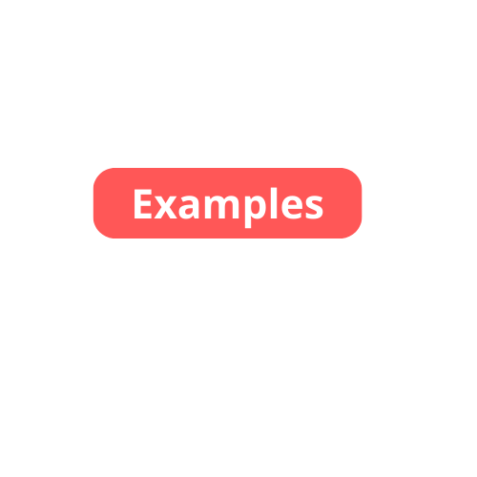
Public cloud deployment model
Public model:
- A cloud hosting provider that provides cloud resources and services to the public for a fee
Amazon Web Services (AWS)
Microsoft Azure
Google Cloud Platform (GCP)
Arno Pretorius

Slide 42



Private cloud deployment model
Private model:
- A cloud hosting provider that provides cloud resources and services privately for security reasons
RedHat
RackSpace
Arno Pretorius

Slide 43

Hybrid cloud deployment model
Hybrid model:
- Some servers are kept on-premise while other services are extended to the cloud
Arno Pretorius

Slide 44
Exploring the different types of cloud computing
Arno Pretorius

Slide 45

Infrastructure as a service
A computing service that offers compute, storage and networking resources on-demand
Amazon EC2
GCP, Azure and Digital Ocean
Arno Pretorius

Slide 46


Infrastructure as a service
Applications
Resources managed by:
YOU
Data
Runtime
Middleware
Resources managed by:
OTHERS
O/S
Virtualization
Servers
Storage
Networking
Arno Pretorius

Slide 47

Platform as a service
Do not need to manage the infrastructure: I.e., servers, databases, file storage systems
Focus on the application code and deployment instead
Heroku
Elastic Beanstalk
Arno Pretorius

Slide 48
Platform as a service
Applications
Data
Resources managed by:
YOU
Runtime
Middleware
Resources managed by:
OTHERS
O/S
Virtualization
Servers
Storage
Networking
Arno Pretorius

Slide 49

Software as a service
A readily available product that is run and managed by a cloud service provider
No management needs to be handled
Gmail
Zoom
Netflix
Arno Pretorius

Slide 50
Software as a service
Applications
Data
Resources managed by:
YOU
Runtime
Middleware
Resources managed by:
OTHERS
O/S
Virtualization
Servers
Storage
Networking
Arno Pretorius

Slide 51
How about on-premises?
Arno Pretorius
Arno Pretorius

Slide 52
on-premises
Applications
Data
Resources managed by:
YOU
Runtime
Middleware
Resources managed by:
OTHERS
O/S
Virtualization
Servers
Storage
Networking
Arno Pretorius

Slide 53
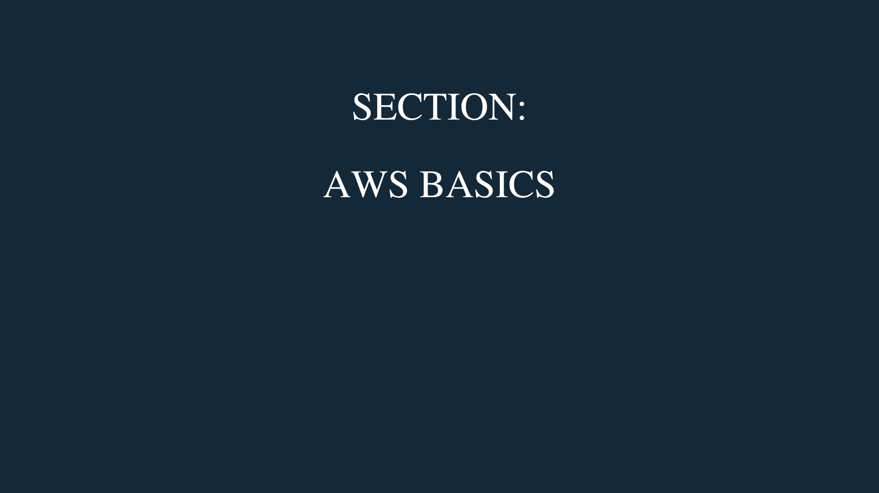
Arno Pretorius

Slide 54
AWS - introduction
Arno Pretorius

Slide 55
Amazon Web Services
Launched in 2002
The most popular cloud service provider
Arno Pretorius

Slide 56


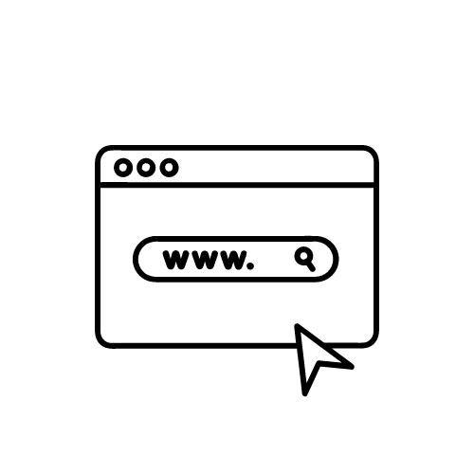
An overview of AWS
Allows us to build complex applications that can be scaled effectively
Is applicable in all industries
Can be used for:
Deploying and hosting websites
Mobile apps
Backup and storage
Arno Pretorius

Slide 57


AWS - Global Infrastructure
Arno Pretorius

Slide 58
AWS - Global Infrastructure
Is composed of:
AWS Regions
AWS Availability Zones
AWS Edge locations
Arno Pretorius

Slide 59
AWS - Regions
Arno Pretorius

Slide 60
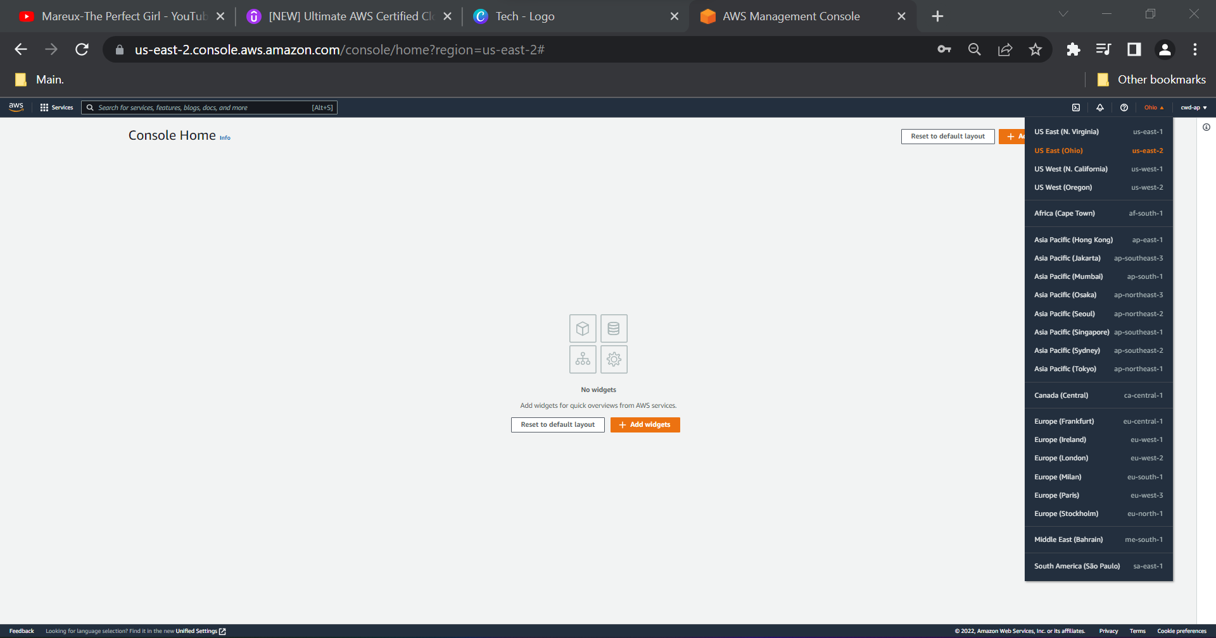
AWS - Regions
Region: us-east-2
An AWS region is a collection / cluster of data centers
There are many aws regions around the world
List of AWS regions:
Region: eu-west-2
Arno Pretorius

Slide 61

AWS - Region - Diagram
Region
Arno Pretorius

Slide 62
AWS - virtual private cloud (VPC)
Arno Pretorius

Slide 63
AWS - Virtual Private Cloud (VPC)
A VPC is a secure and isolated section of the AWS cloud that is situated within a region
Allows us to launch resources within AWS
It is the outer section of an availability zone
Arno Pretorius

Slide 64

VPC - Diagram:
VPC
Arno Pretorius

Slide 65
Architecture so far…
Region
VPC
Arno Pretorius

Slide 66
AWS - availability zones
Arno Pretorius

Slide 67
AWS - Availability Zones
An availability zone can be viewed as a data center or as a set of data centers
Each AWS region has at least 2 availability zones and a maximum of 6 availability zones
Typically, availability zones get referred to as “AZ’s”
Arno Pretorius

Slide 68
Availability Zone - Diagram:
Availability Zone
Treat an availability zone as a data center
Arno Pretorius

Slide 69
Architecture so far…
Region
VPC
Availability Zone
Arno Pretorius

Slide 70
Architecture example:
Each AZ is separated from one another, so if one goes offline, it doesn’t affect the other
Treat an availability zone as a data center
Region
AWS Region:
Europe (London) eu-west-2
VPC
Availability Zone
Availability Zone
Availability Zone
eu-west-2a
eu-west-2b
eu-west-2c
Arno Pretorius

Slide 71
AWS - subnets
Arno Pretorius

Slide 72
AWS - Subnets
Subnets are a range of IP addresses in our VPC that we can attach our AWS resources to
There are two types of subnets:
- Public subnet
- Private subnet
Subnets are created within Availability Zones (AZ’s)
Arno Pretorius

Slide 73


Public and private subnet - Diagrams:
Public subnet
Private subnet
Arno Pretorius

Slide 74
Public Subnet - Diagram:
Public subnet
A public subnet allows resources inside of it to access the internet via the internet gateway
Arno Pretorius

Slide 75

Architecture: 1/2
Public subnet - route table
Destination | Target
172.31.0.0/16 | Local
0.0.0.0/0 | igw-id
Region
Internet gateway
VPC
Availability Zone
Public subnet
Private subnet
Arno Pretorius

Slide 76
Private Subnet - Overview
Private subnet
A private subnet doesn’t accept traffic from the internet
To allow resources to access the internet, they will need to connect to a nat gateway in a public subnet, then access the internet via the internet gateway
Arno Pretorius

Slide 77

Architecture: 2/2
Private subnet - route table
Destination | Target
172.31.0.0/16 | Local
0.0.0.0/0 | nat-gateway-id
Region
Internet gateway
VPC
Availability Zone
Public subnet
Private subnet
NAT gateway
Arno Pretorius

Slide 78
AWS - edge locations
Arno Pretorius

Slide 79
AWS Edge Locations
An edge location is the nearest point to a user who is consuming an AWS service
AWS has well over 200 + edge locations (points of presence) globally
The benefit of an edge location is to deliver content to users at a low latency
The content may for example include PDF documents or images
Arno Pretorius

Slide 80
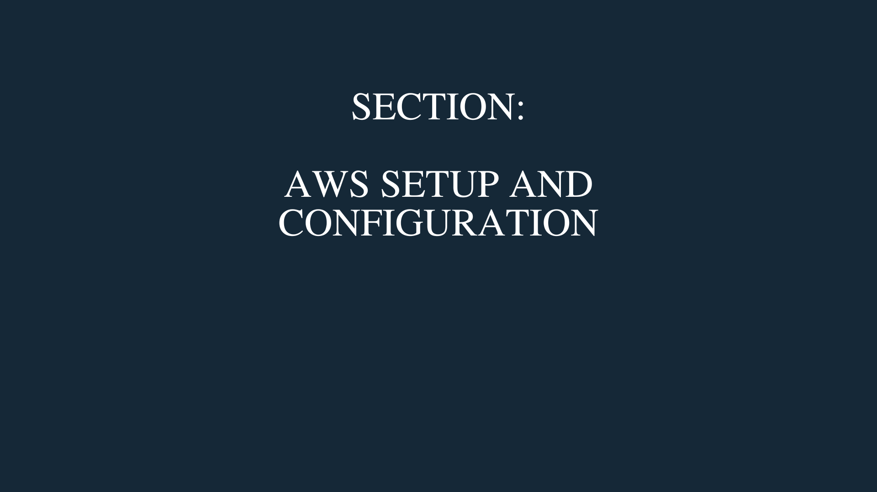
Arno Pretorius
Arno Pretorius

Slide 81
Exploring the aws management console
Arno Pretorius

Slide 82
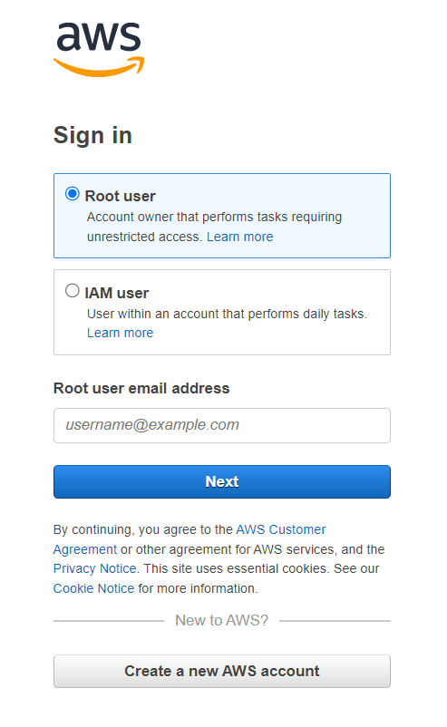
AWS management console
Arno Pretorius

Slide 83
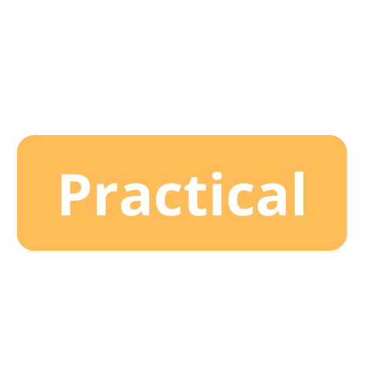
AWS Management Console
Explore the aws management console
Arno Pretorius

Slide 84

Arno Pretorius

Slide 85


AWS Budgets
Arno Pretorius

Slide 86

Budgets - Overview
Allows you to create a simple budget and to send alarms to your email for example, if you are close to or exceeding your designated budget
By setting a budget you can monitor your budget threshold from the start, once it’s reached, and if it has been reached.
It is particularly effective in not only managing your current costs, but also in planning and forecasting costs for the future
Arno Pretorius

Slide 87
Budgets - Overview
Explore the basics of AWS Budgets
Create and set a designated budget
Arno Pretorius

Slide 88

Arno Pretorius

Slide 89

AWS Identity and Access Management
(IAM)
Arno Pretorius

Slide 90
IAM - Overview
IAM - Identity and Access Management
Used to manage user access and to define the identity of your users
By default, you have a root account which you should never use or share with anyone
It is highly recommended to create an IAM user account and use it for AWS
Arno Pretorius

Slide 91

IAM - Users and groups
When you create users, you can choose to group them with others, like so:
Group: Admin
Group: Developers
John
Mike
Jane
Juan
Leon
Kate
Arno Pretorius

Slide 92
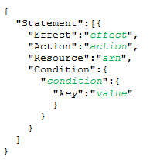

IAM - Policies
You can assign users or groups to have a permission policy
These polices are JSON documents
The polices govern what a user can and cannot do:
I.e., Which AWS resources are allowed to be accessed by which user or group of users.
Permission policy
Arno Pretorius

Slide 93
IAM - Users and groups…
You can assign users or groups to have a permission policy
Group: Admin
Group: Developers
John
Mike
Jane
Juan
Leon
Kate
Permission policy
Arno Pretorius

Slide 94

IAM - Access keys
For each individual IAM user that you create, they are assigned an Access Key and a Secret Access Key
You must under NO circumstances ever share your access keys! Treat your access key as a username and your secret access key as a password
Arno Pretorius

Slide 95
IAM - Overview
Explore the IAM section
Create an IAM user whilst following good standards and principles
Create a group to assign our IAM user
Generate our access keys
Arno Pretorius

Slide 96

IAM - Password policies
What is a password policy, and should you have one?
A password policy is a set of rules that a password must meet, such as the length and the uniqueness of characters
It is recommended to create and manage a password policy in AWS
Arno Pretorius

Slide 97
IAM - Password policies
Create a password policy
Arno Pretorius

Slide 98
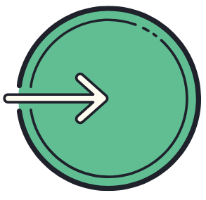
IAM - User sign-in
As an IAM user you can sign in using the default URL or create an account alias to make it more unique
Arno Pretorius

Slide 99
IAM - User sign-in
Sign-in as an IAM user
Customize the sign-in url by creating an account alias
Arno Pretorius

Slide 100

IAM - MFA
It is imperative that you implement MFA (multi-factor authentication) for both your root account and for your IAM user account
The benefit of MFA is that if your password is hacked, then it won’t be possible for hackers to gain access to your account
- MFA authenticator options are:
Authy (RECOMMENDED) or Google Authenticator
Arno Pretorius

Slide 101
IAM - mfa
Enable MFA for your root account
Enable MFA for your user account
Arno Pretorius

Slide 102
Accessing aws
Arno Pretorius

Slide 103


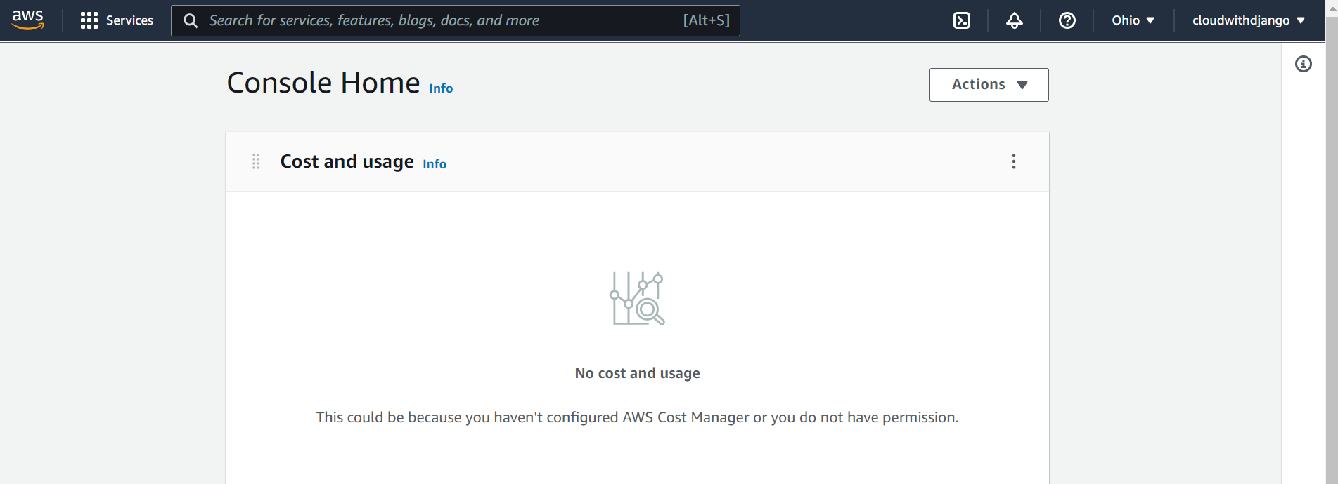
IAM - Accessing AWS
AWS Management Console
A web application that is comprised of a list of services for managing AWS resources
Arno Pretorius

Slide 104


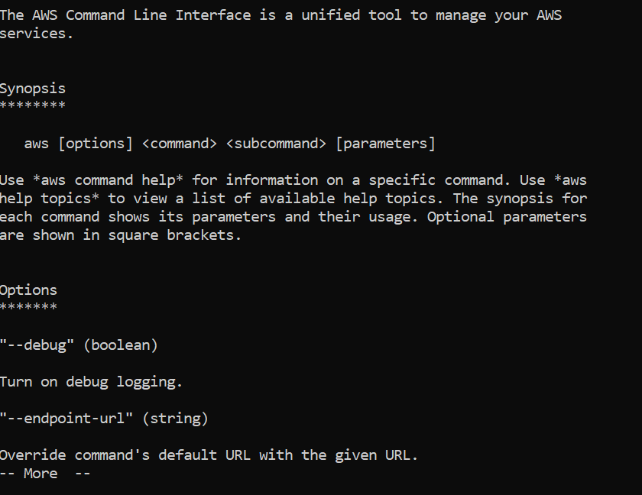
IAM - Accessing AWS…
AWS CLI (Command Line Interface)
It is an open-source tool that we can use to manage and interact with AWS services
Arno Pretorius

Slide 105


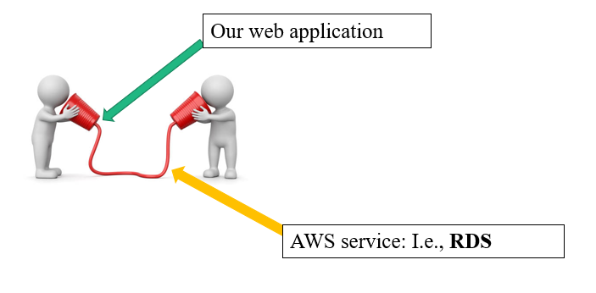

IAM - Accessing AWS…
AWS SDK (Software Development Kit)
It is a software development kit which allows us to manage AWS services programmatically
SDKs (Python, PHP, Java, C++)
Access keys
Arno Pretorius

Slide 106
IAM - Accessing AWS
Setup the AWS CLI
Ensure that the AWS CLI has been installed
Arno Pretorius

Slide 107
AWS CloudShell
Arno Pretorius

Slide 108
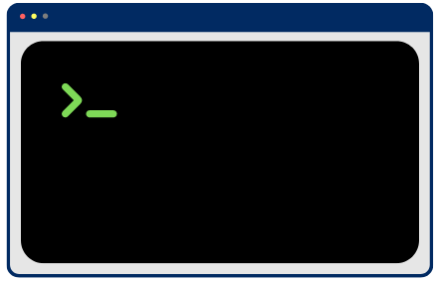
CloudShell - Overview
CloudShell is a browser-based terminal
It is an alternative to using a default terminal like cmd
Arno Pretorius

Slide 109
CloudShell - Overview
Connect to CloudShell and test aws commands
Arno Pretorius

Slide 110

IAM - Security tools
IAM Access advisor:
Shows all the service permissions that have been given to a user and when they last accessed those services
IAM Credentials report:
- A report that shows all the users that have been created under your account
Arno Pretorius

Slide 111
IAM - Security tools
Explore the IAM security tools:
IAM Access advisor
IAM Credentials report
Arno Pretorius

Slide 112

IAM - Roles
Assign permissions to AWS services using IAM roles
This allows for certain aws services to carry out certain actions, as it needs to
AWS service:
I.e., EC2 instance (virtual server)
Arno Pretorius

Slide 113
IAM - Roles
Assign a role to an AWS service
Arno Pretorius

Slide 114

IAM - Best practices
Don’t use the root account, always use your user account as soon as you create it
Enable MFA for your root account and users
Create an effective password policy
Never share your IAM users and access keys with anyone
Assign your users to groups, then add permissions to those groups
Arno Pretorius

Slide 115
IAM - Best practices
Re-explore some of the areas in IAM where we can utilize the best practices
Arno Pretorius

Slide 116
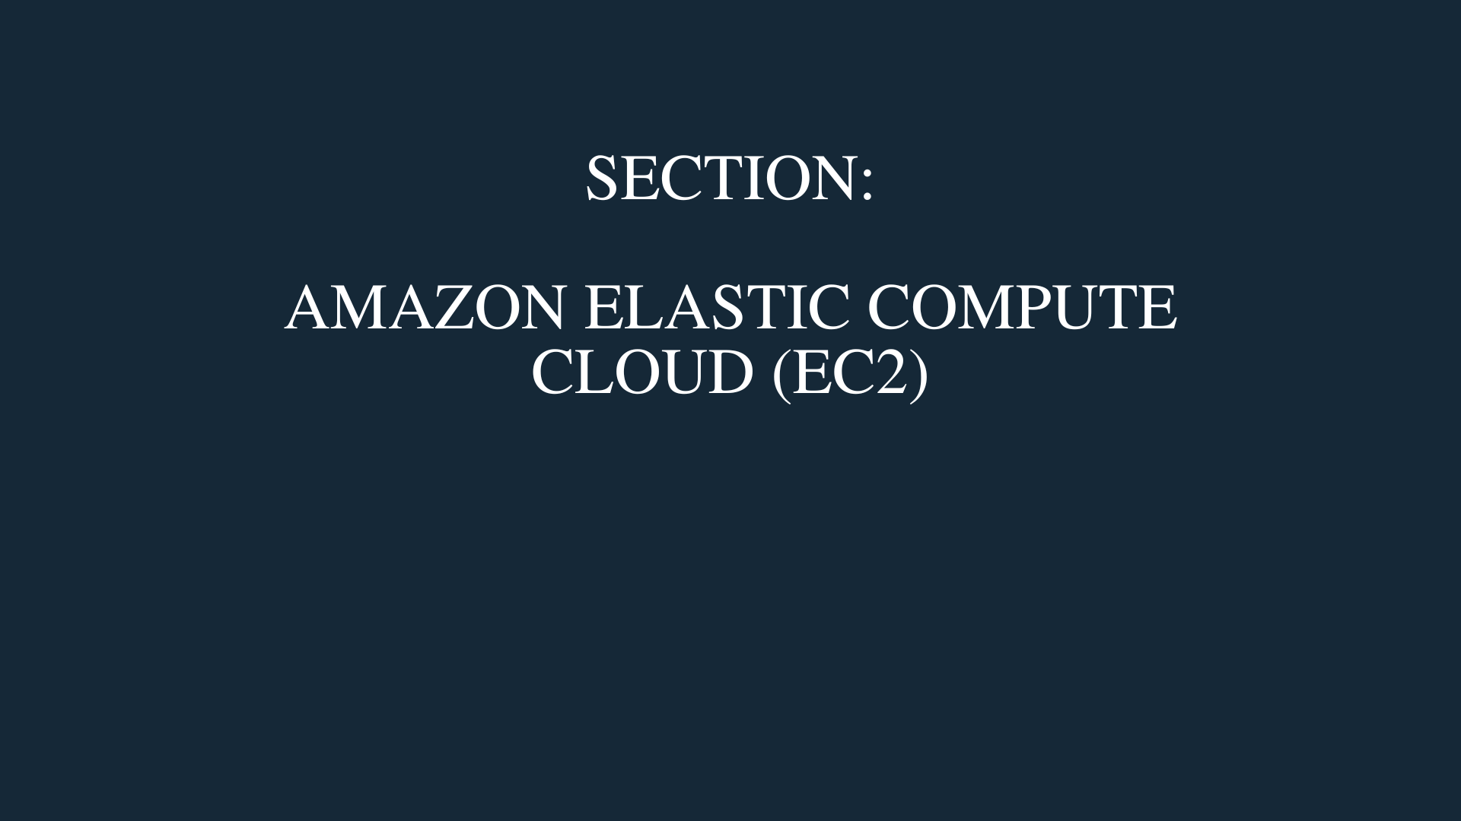
Arno Pretorius

Slide 117

Amazon Elastic Compute Cloud
(EC2)
Arno Pretorius

Slide 118
EC2 - Overview
The main purpose of EC2 is to rent on-demand EC2 instances / virtual servers
EC2 is known as Infrastructure as a Service or more commonly as IaaS
With the EC2 service you will also be able to:
Scale your EC2 instances with an auto scaling group
Distribute the load of internet traffic with an elastic load balancer
Store your data on virtual drives
Arno Pretorius

Slide 119








EC2 - Overview…
Web app/website
/
(OS)
EC2 Instance
Arno Pretorius

Slide 120
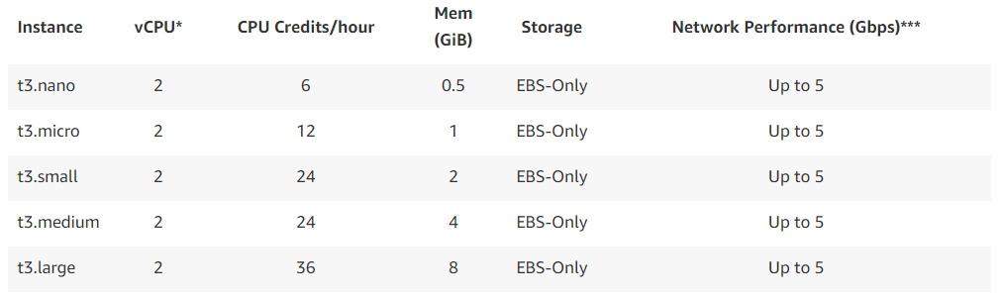
EC2 - Instance types (example)
Arno Pretorius

Slide 121

EC2 - Configuration and setup
Configure and setup an operating system
Compute power requirements? (CPU)
Random-access memory requirements? (RAM)
Decide on your storage space?
Manage and configure our security group (Firewall) for our EC2 instance
Whether we want to run EC2 user data?
Arno Pretorius

Slide 122
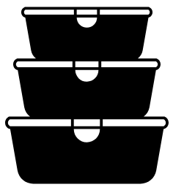
EC2 - Storage space?
For storage space you can utilize:
- Elastic Block Store (EBS) - network based storage
- Elastic File System (EFS) - network based storage
- EC2 instance store - hardware based storage
Arno Pretorius

Slide 123

EC2 - User data?
Is a set of commands or data (in a script) that you can provide your EC2 instance with, just before it is launched
The script can only be launched once, and that is at the beginning of the instance’s first launch
Arno Pretorius

Slide 124
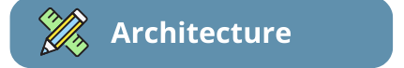
EC2 - Practical
Internet
Client (user)
Region
Internet gateway
VPC
Availability Zone
Public subnet
Private subnet
EC2 Instance
Arno Pretorius

Slide 125
EC2 - Overview
Create an EC2 instance and load user data
Arno Pretorius

Slide 126
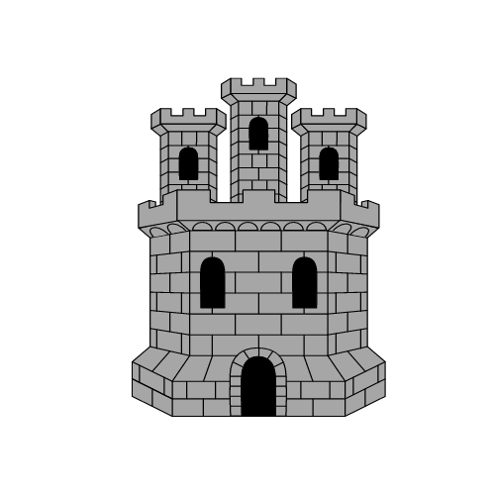


EC2 - Security Groups - (Analogy)
Arno Pretorius

Slide 127

EC2 - Security Groups - (Analogy)
Arno Pretorius

Slide 128
EC2 - Security Groups - (Analogy)
=
=
Internet
EC2 instance
=
=
Security group
Client (user)
Arno Pretorius

Slide 129
EC2 - Security Groups
Security groups control how traffic is allowed into or out of EC2 instances
Try to view security groups as a firewall
Security groups rules can reference either by an IP or by a security group
EC2 instance
Security group
Arno Pretorius

Slide 130
EC2 - Security Groups…
Client (User)
Internet
EC2 instance
Arno Pretorius

Slide 131
EC2 - Security Groups…
Security groups:
Regulate the control of inbound traffic (E.g., Client (users))
Regulate the control of outbound traffic (E.g., EC2 instance)
Regulate IPV4 and IPV6 - IP ranges
Arno Pretorius

Slide 132

EC2 - Important ports
Port 22 = SSH (Secure shell)
Port 80 = HTTP (HyperTextTransferProtocol) - indicates an insecure website
Port 443 = HTTPS (HyperTextTransferProtocolSecure) – indicates a secure website
Arno Pretorius

Slide 133
EC2 - Security Groups
Explore and manage our security groups
Arno Pretorius

Slide 134
EC2 - Instance types - notation
t3.micro
t = instance class
3 = generation
micro = size in the instance class
Arno Pretorius

Slide 135
EC2 - Instance types
General purpose
Compute optimized
Memory optimized
Storage optimized
Accelerated computing
Arno Pretorius

Slide 136
EC2 - General Purpose
General purpose:
General purpose instances provide a balance of memory, compute, and networking resources.
Use cases:
Web application
Code repository
Arno Pretorius

Slide 137
EC2 - Compute Optimized
Compute optimized:
- Compute optimized instances are perfect for compute heavy applications.
Use cases:
Batch processing
Web servers (high performance)
Media transcoding
Arno Pretorius

Slide 138
EC2 - Storage Optimized
Storage optimized
Storage optimized instances are perfect for tasks that are storage-intensive and require read and write access to huge data sets
Use cases:
Relational/non-relational databases
In-memory databases (as a cache – I.e., Memcached / Redis)
Arno Pretorius

Slide 139
EC2 - Memory Optimized
Memory optimized
- Memory optimized instances deliver fast performance to workloads that process rather large data sets in memory
Use cases:
- In-memory databases
Relational/non-relational databases (high performance)
Arno Pretorius

Slide 140
EC2 - Accelerated Computing
Accelerated computing
Accelerated computing instances utilize hardware accelerators to functions.
Use cases:
- Graphics processing
Number calculations
Arno Pretorius

Slide 141
EC2 - Instance types
Explore the different EC2 instance types
Arno Pretorius

Slide 142
EC2 - SSH: with Windows
We can SSH into our EC2 Linux instance - This allows us to remotely access our machine and control it via a command line
Port 22
(SSH)
Client (user)
Internet
Arno Pretorius

Slide 143
Ec2 - SSH
Connect to our EC2 instance via SSH
Arno Pretorius

Slide 144

EC2 - Instance Connect
An alternative to SSH is to use EC2 - Instance Connect
Simply connect and interact with your instance
You must ensure that port 22 is open!
Arno Pretorius

Slide 145
EC2 - Instance Connect
Connect to our EC2 instance via instance connect
Arno Pretorius

Slide 146
EC2 - Instance pricing options
Examples of instance purchasing options:
On-demand instances - pay for your instance per second, has the highest cost, and is very good for unpredictable workloads
Reserved instances - Reserve an instance for a set amount of time - usually for 1-3 years
Spot instances - Get up to a 90% discount, but the instance can be lost at any time
Dedicated hosts - A physical server that has EC2 instance capacity for your use
Arno Pretorius

Slide 147
EC2 - Instance pricing options
Explore the different instance purchasing options
Arno Pretorius

Slide 148
Amazon machine image
(AMI)
Arno Pretorius

Slide 149

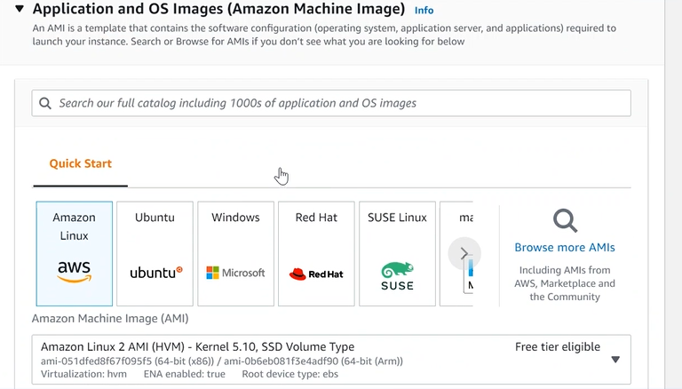
AMI - Overview
AMI - Amazon Machine Image
Arno Pretorius

Slide 150
AMI - Continued…
AMI - Amazon Machine Image
We can launch EC2 instances with:
A public AMI
A third-party AMI
Our own custom-made AMI
Arno Pretorius

Slide 151
AMI - Overview
Create our own AMI
Arno Pretorius

Slide 152

EC2 - Section cleanup
Clean up our resources in EC2 (remove what we don’t need)
Arno Pretorius

Slide 153
EC2 - Section cleanup
Clean up our resources in EC2 (remove what we don’t need)
Arno Pretorius

Slide 154
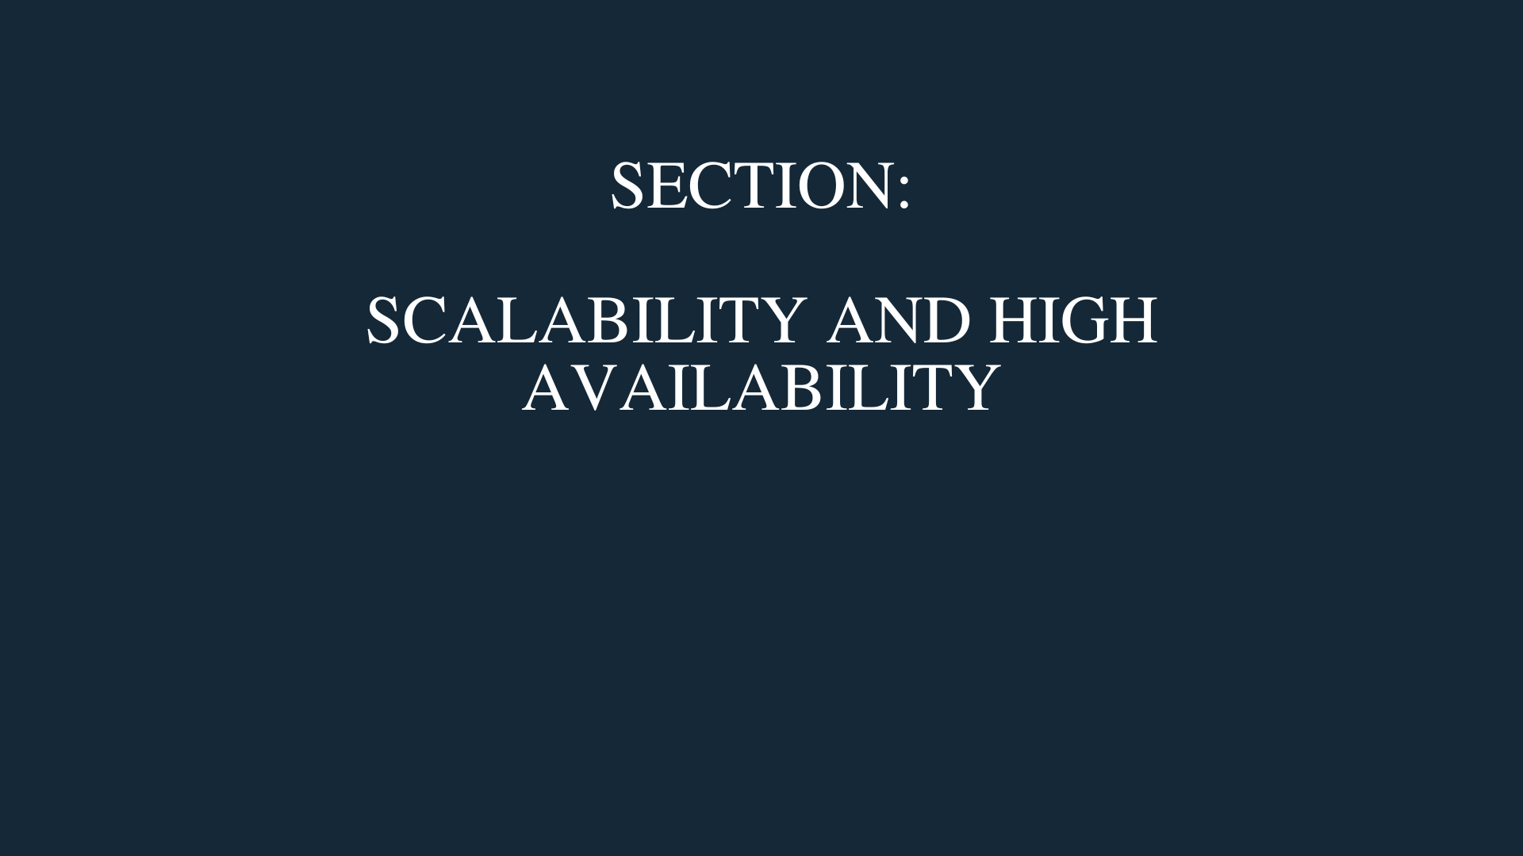
Arno Pretorius

Slide 155
scalability
Arno Pretorius

Slide 156
Scalability
Scalability simply means that an application can adapt to a workload by scaling in size
There are two kinds of scalability:
Vertical scalability
- Horizontal scalability
Arno Pretorius

Slide 157


Vertical scalability
Vertical scalability means that we increase the size of our instance (vertically)
E.g., t3.micro to t3.large
Use case:
- Database
Junior programmer
Senior programmer
Arno Pretorius

Slide 158
Horizontal scalability
Horizontal scalability means that we increase the number of instances (horizontally)
E.g., 4x t3.micro instances
Use case:
- Web application / website
Junior programmer
Junior programmer
Junior programmer
Junior programmer
Arno Pretorius

Slide 159
High availability
Arno Pretorius

Slide 160

Use case scenario
Use case:
Bank:
Users can perform online banking
Arno Pretorius

Slide 161


High Availability
London office
Manchester office
Service desk operators
Service desk operators
Arno Pretorius

Slide 162
High Availability
High availability means to run your application in at least 2 availability zones
The purpose of HA is to minimize disruption to your application in the event of a system outage or natural disaster
Arno Pretorius

Slide 163
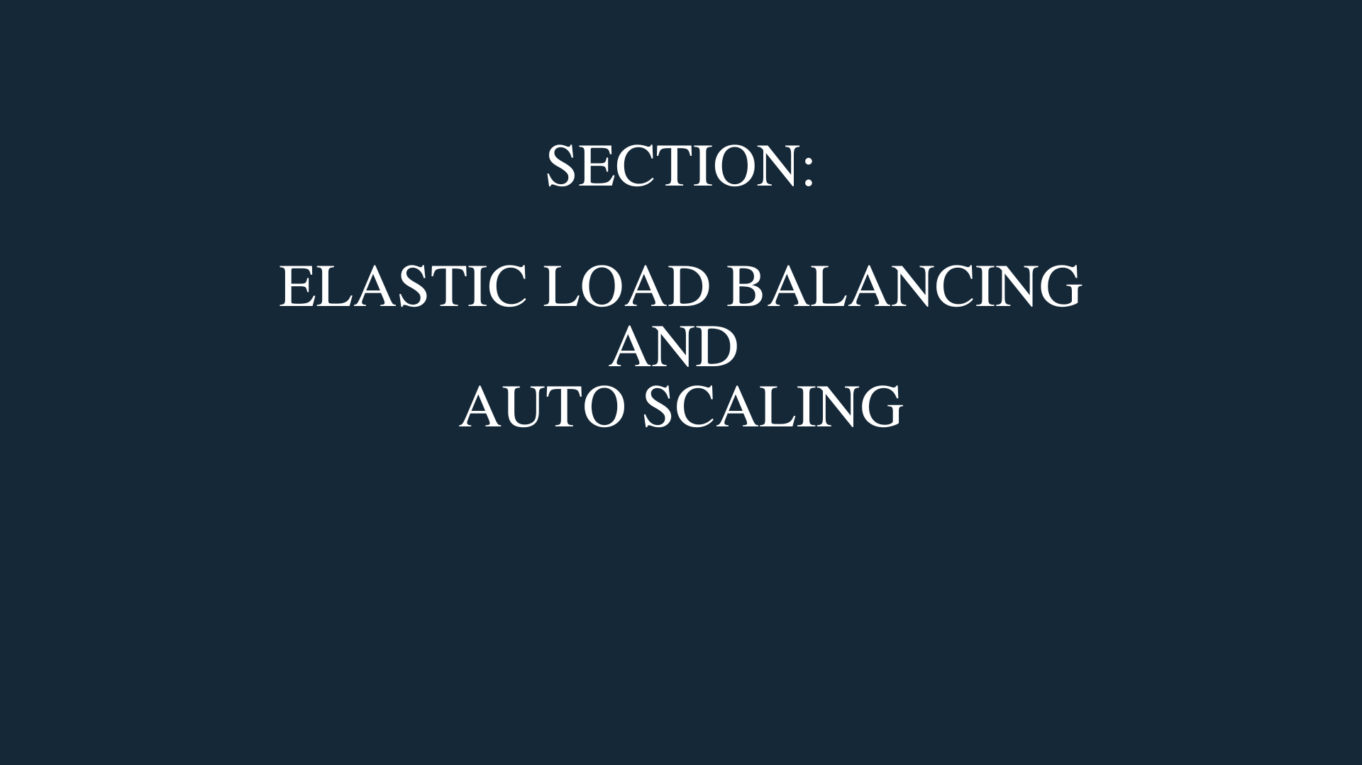
Arno Pretorius

Slide 164

Elastic Load Balancing
(ELB)
Arno Pretorius

Slide 165
ELB - Overview
ELB - Stands for “Elastic Load Balancing”
Load balancers are servers that are used to forward traffic from the internet to multiple servers (EC2 instances)
Arno Pretorius

Slide 166
ELB - How does it work?
User 1
User 2
Internet
Elastic Load balancer
EC2 instances
Arno Pretorius

Slide 167
ELB - Why use it?
So that it can perform health checks on your instances
Spread the load of your traffic downstream across multiple instances
Provide SSL termination (HTTPS) for a website
Arno Pretorius

Slide 168
ELB - Types of load balancers
Application Load Balancer (HTTP/HTTPS)
Network Load Balancer (TCP/UDP)
Gateway Load Balancer
Classic Load Balancer
Arno Pretorius

Slide 169


ELB - Application Load Balancer
Commonly referred to as an “ALB”
Is used for HTTP + HTTPS [layer 7]
Acts as the single point of contact for clients
Use-case: Web applications / websites
Arno Pretorius

Slide 170


ELB - Network Load Balancer
Commonly referred to as an “NLB”
Utilizes TCP/UDP [layer 4]
Used for high performance and for handling millions of requests per second
Use-case: Gaming applications
Arno Pretorius

Slide 171


ELB - Gateway Load Balancer
Used for scaling, deploying and managing virtual network appliances (third-party)
Utilizes third layer of the OSI model - [Network layer]
Use-case: Intrusion detection
Arno Pretorius

Slide 172

ELB - Classic Load Balancer
Utilizes layers 4 + 7 [HTTP, HTTPS + TCP/UDP]
Useful for all kinds of applications
Retiring…
Arno Pretorius

Slide 173

ELB - Practical
Internet
Client (user)
Region
Internet gateway
VPC
Application Load Balancer
Availability Zone
Availability Zone
Public subnet
Private subnet
Public subnet
Private subnet
EC2 Instance
EC2 Instance
Arno Pretorius

Slide 174
Elb - overview
Create an application load balancer
Arno Pretorius

Slide 175

Amazon EC2 Auto Scaling
(ASG)
Arno Pretorius

Slide 176



Website growth
Users
Founded in 2011
Arno Pretorius

Slide 177

Website growth
Users
2017
Arno Pretorius

Slide 178
So, how can we deal with this Increase in traffic?
Arno Pretorius

Slide 179
ASG - Overview
Auto Scaling groups - ASG
Can be used to scale out (increase the number of EC2 instances)
Can be used to scale in (decrease the number of EC2 instances)
Replace unhealthy EC2 instances
Set a maximum and minimum number of instances along with the desired capacity
Register new instances to a load balancer (automatically)
Arno Pretorius

Slide 180
ASG - How does it work?
Users
Internet
Elastic Load Balancer
EC2 instances with an ASG
Arno Pretorius

Slide 181
ASG - Scale out (add)
Users
Internet
Elastic Load Balancer
EC2 instances with an ASG
Arno Pretorius

Slide 182
ASG - Scale in (remove)
Users
Internet
Elastic Load Balancer
EC2 instance with an ASG
Arno Pretorius

Slide 183

ASG - Practical
Internet
Client (user)
Region
Internet gateway
VPC
Application Load Balancer
Availability Zone
Availability Zone
Public subnet
Public subnet
Auto Scaling group
EC2 Instance
EC2 Instance
Arno Pretorius

Slide 184
ASG - Overview
Create an auto scaling group (ASG)
Arno Pretorius

Slide 185
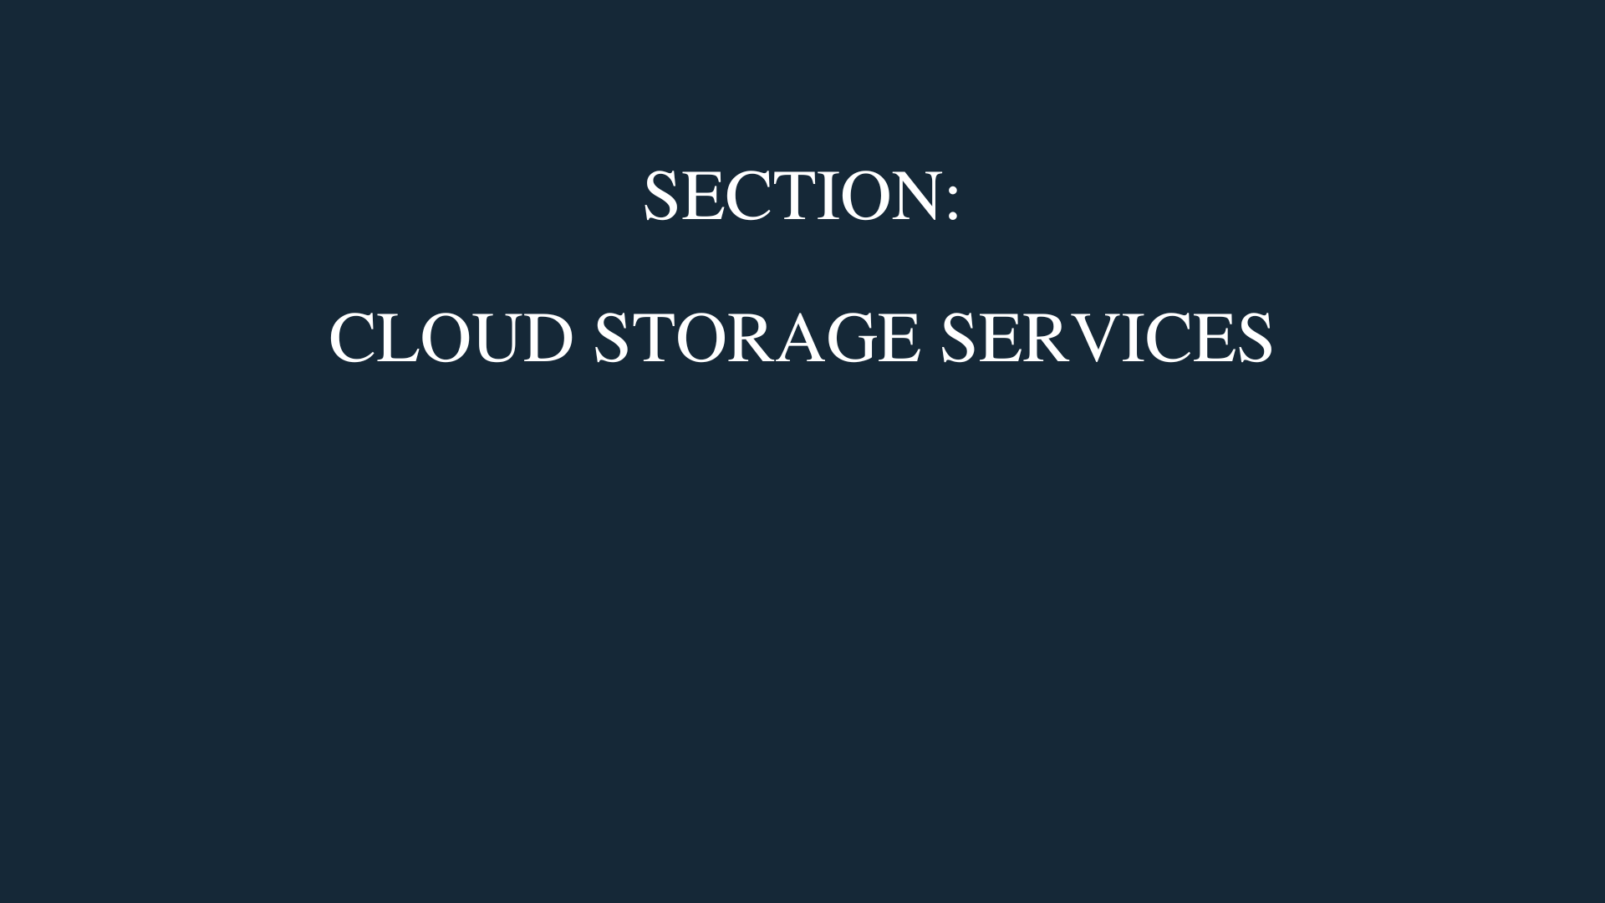
Arno Pretorius

Slide 186
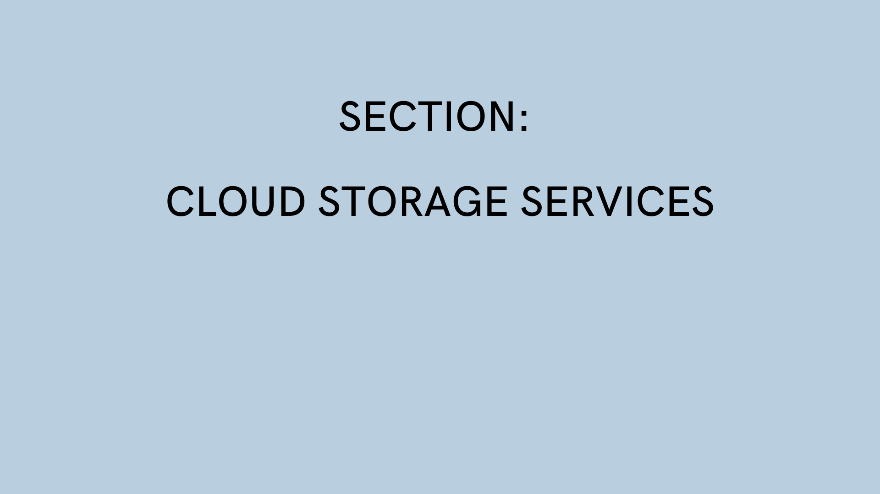

Arno Pretorius

Slide 187

Amazon S3
Arno Pretorius

Slide 188
S3 - Overview
Amazon S3 allows you to store your objects (files) in buckets (directories)
All bucket names must have a unique name
You can use S3 to store any type of file that you want - commonly user images or static files
One of the main building blocks of AWS
Can be used for: backup and storage, hosting static websites, disaster recovery
Arno Pretorius

Slide 189



S3 - How it works (simplified)
Objects
Upload
Create
Client (user)
Internet
Amazon S3
Bucket
Arno Pretorius

Slide 190
S3 - Overview
Explore Amazon S3
Create a bucket, store an object (file) in it, and view it via a URL
Arno Pretorius

Slide 191
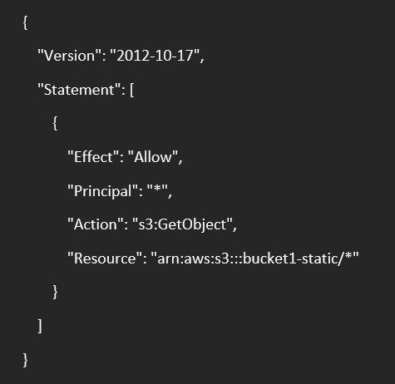
S3 - Bucket policies
S3 bucket policies are composed of JSON documents
Bucket policies are used to grant users access permissions to a bucket and its objects
Arno Pretorius

Slide 192
S3 - Bucket policies…
Resource
- Bucket
Action
- What type of API we want to use
Principal
- The entity to apply the bucket policy to
Effect
- Allow or deny the policy
Arno Pretorius

Slide 193
S3 - Bucket policies
Create an S3 bucket policy
Arno Pretorius

Slide 194

S3 - Encryption
No encryption
Server-side encryption
Client-side encryption
Arno Pretorius

Slide 195


S3 - Client-side encryption
User
Encryption takes place at the server
The user encrypts the file before it is uploaded
Arno Pretorius

Slide 196
S3 - Server-side encryption
User
Encryption takes place at the server
Arno Pretorius

Slide 197
S3 - No-encryption
User
No encryption takes place during the file upload process
Arno Pretorius

Slide 198
S3 - Encryption
Re-view how to enable server-side encryption
Arno Pretorius

Slide 199
S3 - Static websites
You can also host static websites with S3
Arno Pretorius

Slide 200
S3 - Static websites
Create and host a static website with Amazon S3
Arno Pretorius

Slide 201

S3 - Bucket versioning
We can allow our files to have versions
Allows us to automatically update our files without creating another separate file
Easily rollback changes to an older file version
Arno Pretorius

Slide 202
S3 - Bucket versioning…
+ V3
+ V2
+ V2
+ V1
+ V1
+ V1
Arno Pretorius

Slide 203
S3 - Bucket versioning
Enable bucket versioning on an S3 bucket
Arno Pretorius

Slide 204
S3 - Access logging
Send access logs to a separate S3 bucket of all the users that have been accessing S3 buckets
Helpful: carrying out audits, and for investigating potential suspicious behaviour
Arno Pretorius

Slide 205
S3 - Access logging…
bucket1
Requests to bucket
User
Log all the requests from bucket1
Logging bucket
Arno Pretorius

Slide 206
S3 - Access logging
Send access logs from an S3 bucket to another S3 bucket (used for receiving these logs)
Arno Pretorius

Slide 207

S3 - Replication
If we want to move objects (files) from one bucket to another:
We can use either - (CRR) Cross-Region Replication
OR
We can enable - (SRR) Same-Region Replication
Versioning must be enabled in the source and destination buckets!
Arno Pretorius

Slide 208
S3 - Replication
Perform (CRR) on our S3 buckets
Arno Pretorius

Slide 209
S3 - Storage classes
Amazon S3 Standard - General Purpose
Amazon S3 Standard - Infrequent Access
Amazon S3 One Zone-Infrequent Access
Amazon S3 Glacier Instant Retrieval
Amazon S3 Glacier Deep Archive
Amazon S3 Glacier Flexible Retrieval
Amazon S3 Intelligent Tiering
Arno Pretorius

Slide 210
S3: Standard - General Purpose
Used for data that is frequently accessed
Arno Pretorius

Slide 211


S3: Standard - Infrequent Access + One Zone Infrequent Access
Used for data that is in-frequently accessed
The data must be received quickly though when accessed
Arno Pretorius

Slide 212



S3: Glacier
Storage that is used for backing up and archiving data:
Amazon S3 Glacier Instant Retrieval
Amazon S3 Glacier Deep Archive
Amazon S3 Glacier Flexible Retrieval
Arno Pretorius

Slide 213

S3: Intelligent-Tiering
Is used to move objects (files) between different access tiers
Some access tiers include:
Frequent access tier
Infrequent access tier
Archive access tier
Arno Pretorius

Slide 214
S3 - Storage classes
Explore the S3 storage classes
Arno Pretorius

Slide 215

S3 - Object lock
Lock an object so that it can’t be modified or deleted for a fixed amount of time or indefinitely
Follows a WORM model - (Write Once and Read Many)
Arno Pretorius

Slide 216
S3 - Object lock
Enable S3 object lock
Arno Pretorius

Slide 217
S3 - Transfer acceleration
S3 transfer acceleration is mainly used to speed up the upload process of files to an S3 bucket
Arno Pretorius

Slide 218
S3 - Transfer acceleration
Observe a simulation of S3 Transfer acceleration
Arno Pretorius

Slide 219

S3 - Section cleanup
Clean up our resources in S3 (remove what we don’t need)
Arno Pretorius

Slide 220
S3 - Section cleanup
Clean up our resources in S3 (remove what we don’t need)
Arno Pretorius

Slide 221
EC2 - Storage space?
Arno Pretorius

Slide 222
EC2 - Storage space?
Storage space can be:
(EBS or EFS): network based
(EC2 Instance Store): hardware based
Arno Pretorius

Slide 223
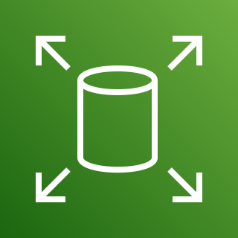
Amazon Elastic Block Store
(EBS)
Arno Pretorius

Slide 224

EBS - Overview
EBS, otherwise referred to as an EBS volume is a network drive which you can attach to your EC2 instances
EBS volumes can be detached from one EC2 instance and attached to another EC2 instance
Availability zone specific (cannot be moved to another AZ after it has been defined) - unless you create a snapshot
The capacity size of an EBS volume is in GB’s and IOPS
Arno Pretorius

Slide 225
EBS - Overview…
At a basic level:
EBS volumes cannot be attached to more than one EC2 instance at a time
At a more advanced level:
- EBS volumes (using io1 and io2) can be attached to more than one EC2 instance at a time, using Multi-Attach
Arno Pretorius

Slide 226

EBS - Architecture
Next, we will examine a few diagram’s illustrating how EBS volumes work with EC2 instances
These diagrams highlight what is allowed and not allowed with EBS volumes:
Each correct implementation of EBS will be denoted with a tick
Each in-correct implementation of EBS will be denoted with a cross
Arno Pretorius

Slide 227

EBS - How it works?
Only 1 EBS volume can be attached to one EC2 instance at a time
Region
AWS Region:
Europe (London) eu-west-2
Availability Zone
eu-west-2a
Amazon Elastic Block Store (EBS)
EC2 Instance
EC2 Instance
Arno Pretorius

Slide 228
EBS - How it works?
Only 1 EBS volume can be attached to one EC2 instance at a time
Region
AWS Region:
Europe (London) eu-west-2
Availability Zone
eu-west-2a
Amazon Elastic Block Store (EBS)
EC2 Instance
EC2 Instance
Arno Pretorius

Slide 229
EBS - How it works?
Only 1 EBS volume can be attached to one EC2 instance at a time
Region
AWS Region:
Europe (London) eu-west-2
Availability Zone
eu-west-2a
Amazon Elastic Block Store (EBS)
EC2 Instance
EC2 Instance
Arno Pretorius

Slide 230
EBS - How it works?
EBS volumes are locked to an AZ
Region
AWS Region:
Europe (London) eu-west-2
Availability Zone
Availability Zone
eu-west-2a
eu-west-2b
Amazon Elastic Block Store (EBS) - Unattached
EC2 Instance
Arno Pretorius

Slide 231
EBS - How it works?
Multiples EBS volumes can be attached to an instance
Region
AWS Region:
Europe (London) eu-west-2
Availability Zone
eu-west-2a
Amazon Elastic Block Store (EBS)
Amazon Elastic Block Store (EBS)
EC2 Instance
Arno Pretorius

Slide 232
EBS - Overview
Create an EBS volume
Arno Pretorius

Slide 233

EBS - Snapshots
We can make a backup / “snapshot” of our EBS volume
Allows us to copy our snapshot across an availability zone or region
Arno Pretorius

Slide 234
EBS - Architecture…
Next, we will examine a few diagram’s illustrating how EBS volumes work with EC2 instances
These diagrams highlight what is allowed and not allowed with EBS volumes:
Each correct implementation of EBS will be denoted with a tick
Each in-correct implementation of EBS will be denoted with a cross
Arno Pretorius

Slide 235
EBS - How it works?
EBS volumes are locked to an AZ
Region
AWS Region:
Europe (London) eu-west-2
Availability Zone
Availability Zone
eu-west-2a
eu-west-2b
Amazon Elastic Block Store (EBS) - Unattached
EC2 Instance
Arno Pretorius

Slide 236
EBS - How it works?
Move an EBS volume across an AZ by creating a snapshot
Region
AWS Region:
Europe (London) eu-west-2
Availability Zone
Availability Zone
eu-west-2a
eu-west-2b
EC2 Instance
EC2 Instance
Snapshot
Restore
EBS Volume
EBS Volume
Amazon S3 bucket
Arno Pretorius

Slide 237
EBS - Overview
Create an EBS snapshot
Arno Pretorius

Slide 238

Amazon Elastic File System
(EFS)
Arno Pretorius

Slide 239
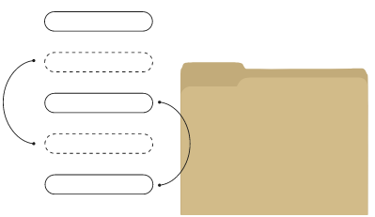
EFS - Overview
EFS is a serverless service that stands for “Elastic File System”
It is a scalable file storage system that provides storage for EC2 instances
This “Elastic File System” can be attached to hundreds of EC2 instances at a time
Arno Pretorius

Slide 240
What about ec2 instance store?
Arno Pretorius

Slide 241

EC2 Instance store - Overview
An EC2 - Instance store is a type of hardware disk, that is used when you want short-term high performance
Arno Pretorius

Slide 242
EC2 Instance store - Overview
Identify an EC2 Instance store
Arno Pretorius

Slide 243
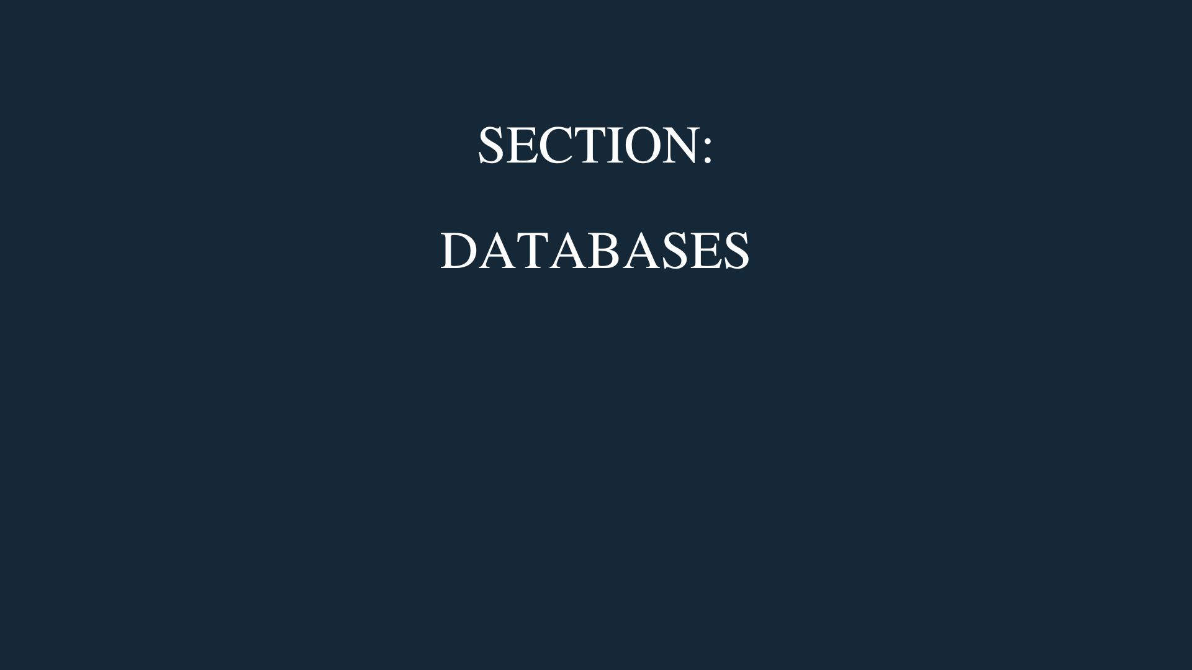
Arno Pretorius

Slide 244
An introduction to databases
Arno Pretorius

Slide 245

So, what is a database?
A database is an organized collection of data that is accessed and stored electronically
The data that is stored in a database is structured
Arno Pretorius

Slide 246


How does a database work?
Post request
Online form
Database
Arno Pretorius

Slide 247
The types of databases
There are two types of databases, namely:
Relational database
Non-relational database
Arno Pretorius

Slide 248
Relational database
A relational database stores data in rows and columns like a spreadsheet
Uses SQL
TASK
Id
task_name
task_description
employee_name
STUDENT
Id
student_name
student_grade
student_age
Arno Pretorius

Slide 249
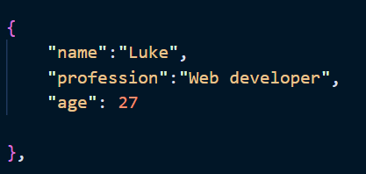
Non-relational database
A non-relational database uses a storage model to store data
Doesn’t use SQL
E.g., We can store data in a JSON format:
Arno Pretorius

Slide 250

Amazon Relational Database Service
(RDS)
Arno Pretorius

Slide 251
RDS - Overview
RDS is a managed relational database service
With this service you will be able to create relational databases in AWS
Such databases include, but are not limited to:
- PostgreSQL
- MySQL
- Oracle
Arno Pretorius

Slide 252
RDS - Practical
Region
VPC
Availability Zone
Public subnet
Private subnet
RDS Instance
Arno Pretorius

Slide 253
RDS - Overview
Create an RDS DB instance
Arno Pretorius

Slide 254
RDS -
Deployment configurations
Arno Pretorius

Slide 255
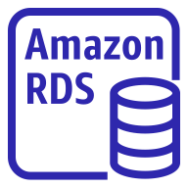

1) - Add a Read Replica
Read
Read replica
Write
Main
Read
Read replica
Read
Application
Arno Pretorius

Slide 256
1) - Add a Read Replica…
By adding more read replicas this will help to scale the read workload of our database
We can create up to 5 read replicas
Data that is written is only written to our main database
Arno Pretorius

Slide 257
2) - Create a Multi-AZ…
Failover DB
Replicate
Write
Main
Read
Application
Arno Pretorius

Slide 258

Amazon DynamoDB
Arno Pretorius

Slide 259
DynamoDB - Overview
DynamoDB is a managed, serverless, key-value non-relational database service
Extremely fast and consistent
Handles millions of requests per second at a low-latency
Highly scalable and can scale to huge workloads
Arno Pretorius

Slide 260
DynamoDB - Composition
DynamoDB is composed of:
Tables
studentID
studentName
studentGrade
student001
mike
80
student002
jane
95
student003
henry
72
Arno Pretorius

Slide 261
DynamoDB - Composition…
DynamoDB is composed of:
Tables
Items
studentID
studentName
studentGrade
student001
mike
80
student002
jane
95
student003
henry
72
Arno Pretorius

Slide 262
DynamoDB - Composition…
DynamoDB is composed of:
Tables
Items
Attributes
studentID
studentName
studentGrade
student001
mike
80
student002
jane
95
student003
henry
72
Arno Pretorius

Slide 263
DynamoDB - Overview
Create a DynamoDB table
Arno Pretorius

Slide 264
DAX
Arno Pretorius

Slide 265
DynamoDB - Accelerator (DAX)
In-memory cache specifically for DynamoDB
Drastically improves the performance of DynamoDB when you read your tables
DAX - Highly available and scalable
Arno Pretorius

Slide 266

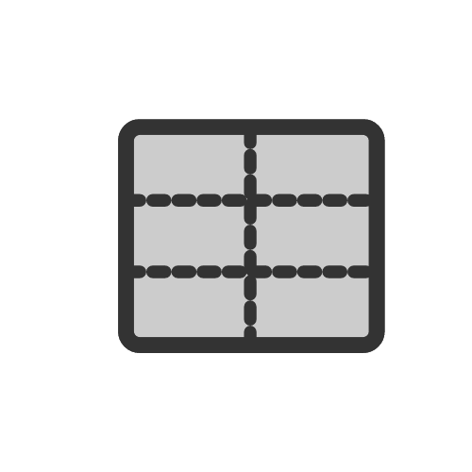
DynamoDB - Accelerator (DAX)
Application
DynamoDB accelerator (DAX)
DynamoDB with tables
Arno Pretorius

Slide 267

Amazon ElastiCache
Arno Pretorius

Slide 268

ElastiCache - Overview
ElastiCache is used to get a managed Redis or Memcached database
Reduces the workload off databases
A cache is an in-memory database
Use case:
- Cache user sessions while accessing a website
Arno Pretorius

Slide 269
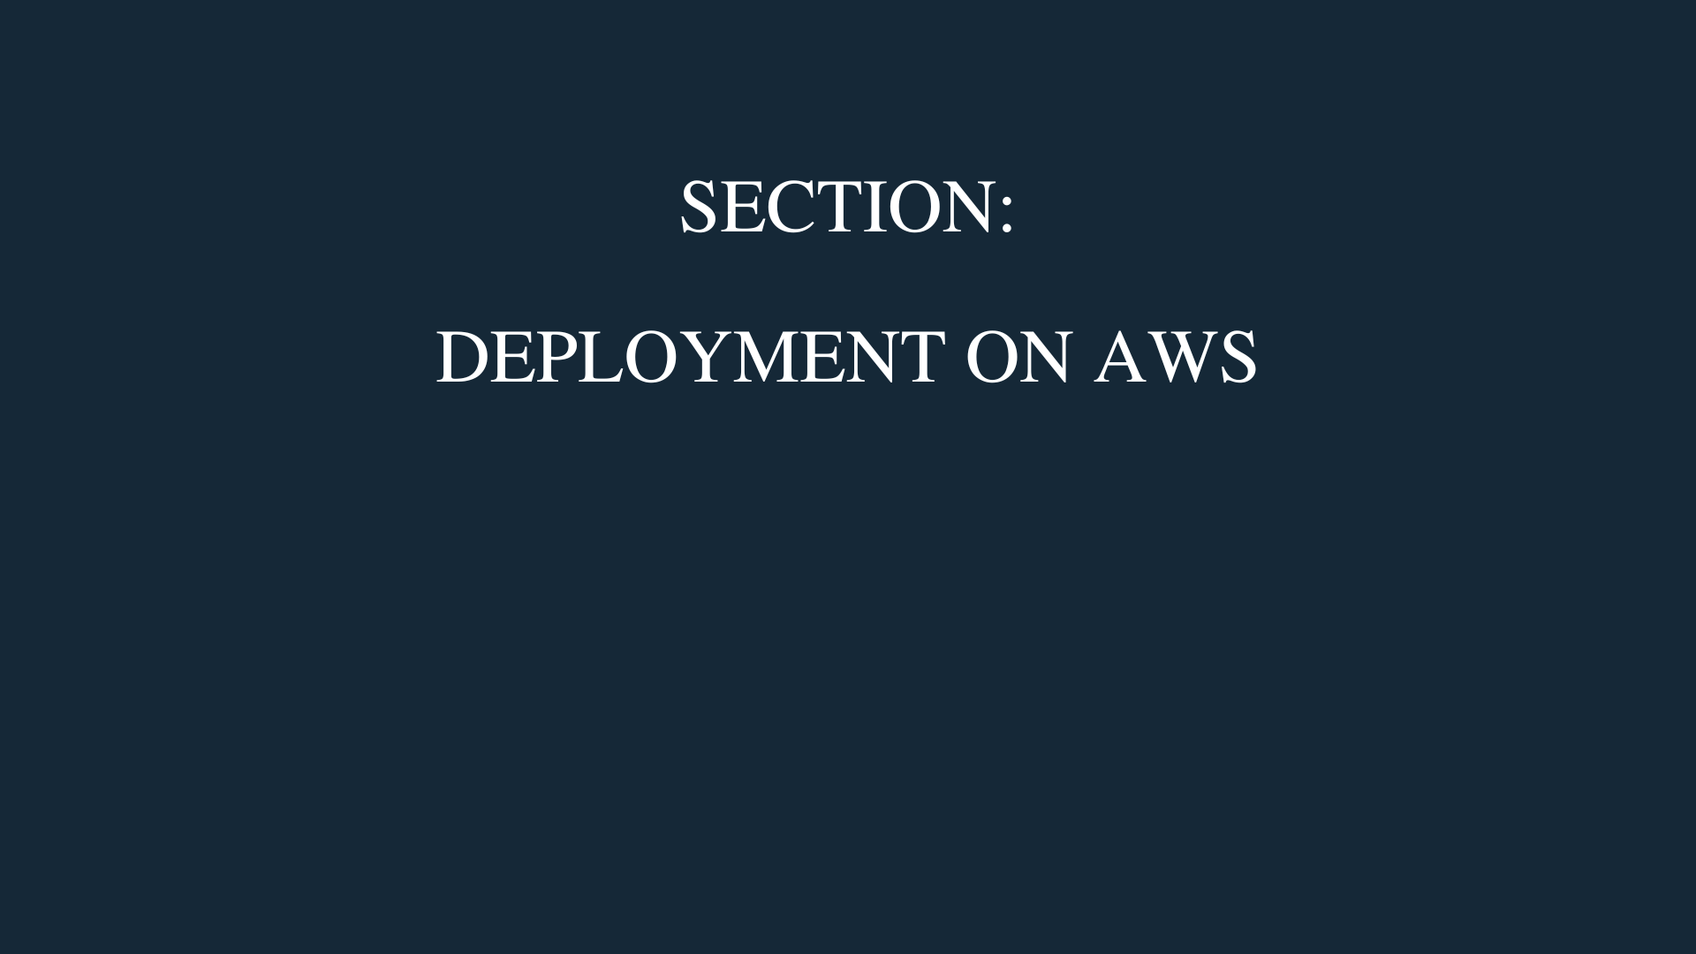
Arno Pretorius

Slide 270

AWS CloudFormation
Arno Pretorius

Slide 271
CloudFormation - Overview
CloudFormation is a method used to provision AWS infrastructure within a template
You may define in your CloudFormation template, that you want:
- Three EC2 instances
A security group to be attached to these instances
A load balancer (ELB) to be placed in-front of these instances
Arno Pretorius

Slide 272
CloudFormation - Overview
Create a simple stack using CloudFormation
Arno Pretorius

Slide 273

AWS Elastic Beanstalk
Arno Pretorius

Slide 274
Possible developer problems?
Only wants to deploy their application!
Doesn’t know how to manage infrastructure (databases, ASG, ELB or EC2 instances)
Not sure of how to scale their application
Arno Pretorius

Slide 275
So, how can we help the developer, in this situation?
Arno Pretorius

Slide 276
Elastic Beanstalk - Overview
AWS Elastic Beanstalk is our answer, and offers PaaS
It takes care of all the infrastructure for us… For example: EC2 instances, ELB, ASG, RDS etc..
Allows the developer to only focus on deploying their application
Arno Pretorius

Slide 277
Elastic Beanstalk - Overview
Create a sample application using Elastic Beanstalk
Arno Pretorius

Slide 278
CI/CD - Introudction
Arno Pretorius

Slide 279

CI/CD - Overview
CI/CD: Continuous Integration and Continuous Delivery
In simple terms, it is a software development practice where updates to code are made often and reliably - hence, “continuous”
Arno Pretorius

Slide 280
CI/CD In Aws?
Arno Pretorius

Slide 281

AWS CodeCommit
Arno Pretorius

Slide 282

CodeCommit - Overview
A “git-hub like” repository where we can store our code
It is therefore a source-control service that utilizes git technology
Fully managed, scalable and highly available
Arno Pretorius

Slide 283

AWS CodeBuild
Arno Pretorius

Slide 284

CodeBuild - Overview
A service that is used for compiling source code, running tests, and producing packages
These packages get sent to CodeDeploy to await deployment
Arno Pretorius

Slide 285

AWS CodeDeploy
Arno Pretorius

Slide 286

CodeDeploy - Overview
An AWS service that allows us to quickly deploy or re-deploy our application
It ensures that your application is not disrupted in anyway by offering zero-down time deployment (blue/green deployment)
Arno Pretorius

Slide 287

AWS CodePipeline
Arno Pretorius

Slide 288
CodePipeline - Overview
Used to orchestrate the various stages needed for application code to be deployed
Arno Pretorius

Slide 289


CI/CD - Diagram:
AWS CodePipeline
Build and test our code
Code will be pushed for deployment
The code is pushed to our application
Push our code
AWS CodeCommit
AWS CodeBuild
AWS CodeDeploy
Send test results of the build back to the developer
Application
Arno Pretorius

Slide 290

AWS CodeStar
Arno Pretorius

Slide 291

CodeStar - Overview
A service which allows you to quickly build, develop and deploy applications
Arno Pretorius

Slide 292
CI/CD - Overview
Create an AWS CodeStar project
Arno Pretorius

Slide 293

AWS CodeArtifact
Arno Pretorius

Slide 294

CodeArtifact - Overview
A fully managed artifact repository service used to store and share software packages that are used for developing applications
Arno Pretorius

Slide 295

AWS Cloud9
Arno Pretorius

Slide 296

Cloud9 - Overview
A cloud IDE (Integrated Development Environment) for writing and running code
Very similar to other IDEs like Visual Studio
The Cloud9 IDE can be run within the web browser
Arno Pretorius

Slide 297
Cloud9 - Overview
Create a Cloud9 environment
Arno Pretorius

Slide 298
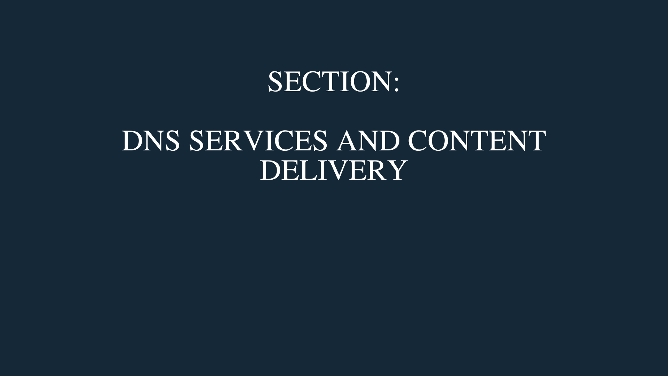
Arno Pretorius

Slide 299

AWS Route 53
Arno Pretorius

Slide 300


Route 53 - Overview
Route53 is DNS (Domain Name System) Service
DNS consists of a collection of rules and records which are used to help users connect to infrastructure on AWS
We can create records for a variety of uses, including but not limited to:
- Domain registration
- Mapping domain names to AWS EC2 instances
- Identifying email servers
Arno Pretorius

Slide 301

Route 53 - The most common use case?
Domain name registration
.com
.net
.org
E.g., edenthought.com
Arno Pretorius

Slide 302
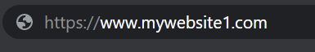


Route 53 - DNS resolution
Name | Type | Value
mywebsite1.com | A | 192.168.0.1
The user will enter the website’s domain name in the browser
The DNS server resolves the domain name to the IP address of our application/web server
DNS server
The computer will connect to our website via the IP address
Application/web server
Arno Pretorius

Slide 303
Route 53 - DNS records
There are many DNS records, but here are the most common ones:
A (IPV4)
AAAA (IPV6)
CNAME
ALIAS
www.youtube.com
=>
12.35.55.77
www.youtube.com
=>
2001:0db8:85a3:0000:0000:8a2e:0370:7334.
videos.youtube.com
=>
youtube.com
CNAME - hostname to hostname
mywebsite1.com
=>
AWS resource
ALIAS (E.g., ELB, S3, CloudFront)
Arno Pretorius

Slide 304
Route 53 - Routing policies
Route 53 has routing policies which is used to determine how AWS should respond to DNS queries
Route 53 policies:
Simple routing policy
Weighted routing policy
Failover routing policy
Latency routing policy
Arno Pretorius

Slide 305
Route 53 - Simple routing policy
mywebsite1.com
21.33.44.11
User
Route 53
A record
Arno Pretorius

Slide 306
Route 53 - Weighted routing policy
60%
30%
EC2 Instances
10%
Route 53
Arno Pretorius

Slide 307


Route 53 - Failover routing policy
Health check
Main/primary EC2 instance
Failover EC2 instance
User
Arno Pretorius

Slide 308

Route 53 - Latency routing policy
Arno Pretorius

Slide 309
Route 53 - Overview
Register a domain name in Route 53 (optional)
Assign a domain name to an EC2 instance (optional)
Arno Pretorius

Slide 310

AWS Certificate Manager
(ACM)
Arno Pretorius

Slide 311

ACM - Overview
ACM allows you to create and deploy SSL/TLS certificates
All public TLS certificates that are provisioned by AWS are FREE
SSL/TLS certificates allow your website to be secure with HTTPS
Arno Pretorius

Slide 312


ACM - Important to know…
http://mywebsite1.com
In-secure website
https://mywebsite2.com
Secure website
Arno Pretorius

Slide 313
ACM - Overview
Identify a secure and an in-secure website
Provision an SSL certificate (optional)
Attach our SSL certificate to our domain name (optional)
Arno Pretorius

Slide 314

Amazon CloudFront
Arno Pretorius

Slide 315
CloudFront - Overview
CloudFront is a content delivery network or CDN that is used to deliver content to users around the world
This content may include images, text files or videos
It is used to improve read performance and to reduce latency; this is done by caching content at edge locations
There are several edge locations that are located globally
Arno Pretorius

Slide 316
CloudFront - Origins
Amazon S3
An S3 bucket can be used to distribute and cache files at the edge
HTTP origin
- EC2 instance / Application Load Balancer
Arno Pretorius

Slide 317




CloudFront - How it works?
Arno Pretorius

Slide 318

CloudFront - How it works?
Edge location
Arno Pretorius

Slide 319
CloudFront - Overview
Create a CloudFront distribution
Arno Pretorius

Slide 320

AWS Global Accelerator
Arno Pretorius

Slide 321

Global Accelerator - Overview
AWS Global Accelerator is a service that allows you to create ‘accelerators’ which is used to improve your applications’ performance and availability
You can see up to a 60% improvement with Global Accelerator
The downfall is that it can get expensive to use
Arno Pretorius

Slide 322
Global Accelerator - Overview
Run a speed test with global accelerator
Arno Pretorius

Slide 323
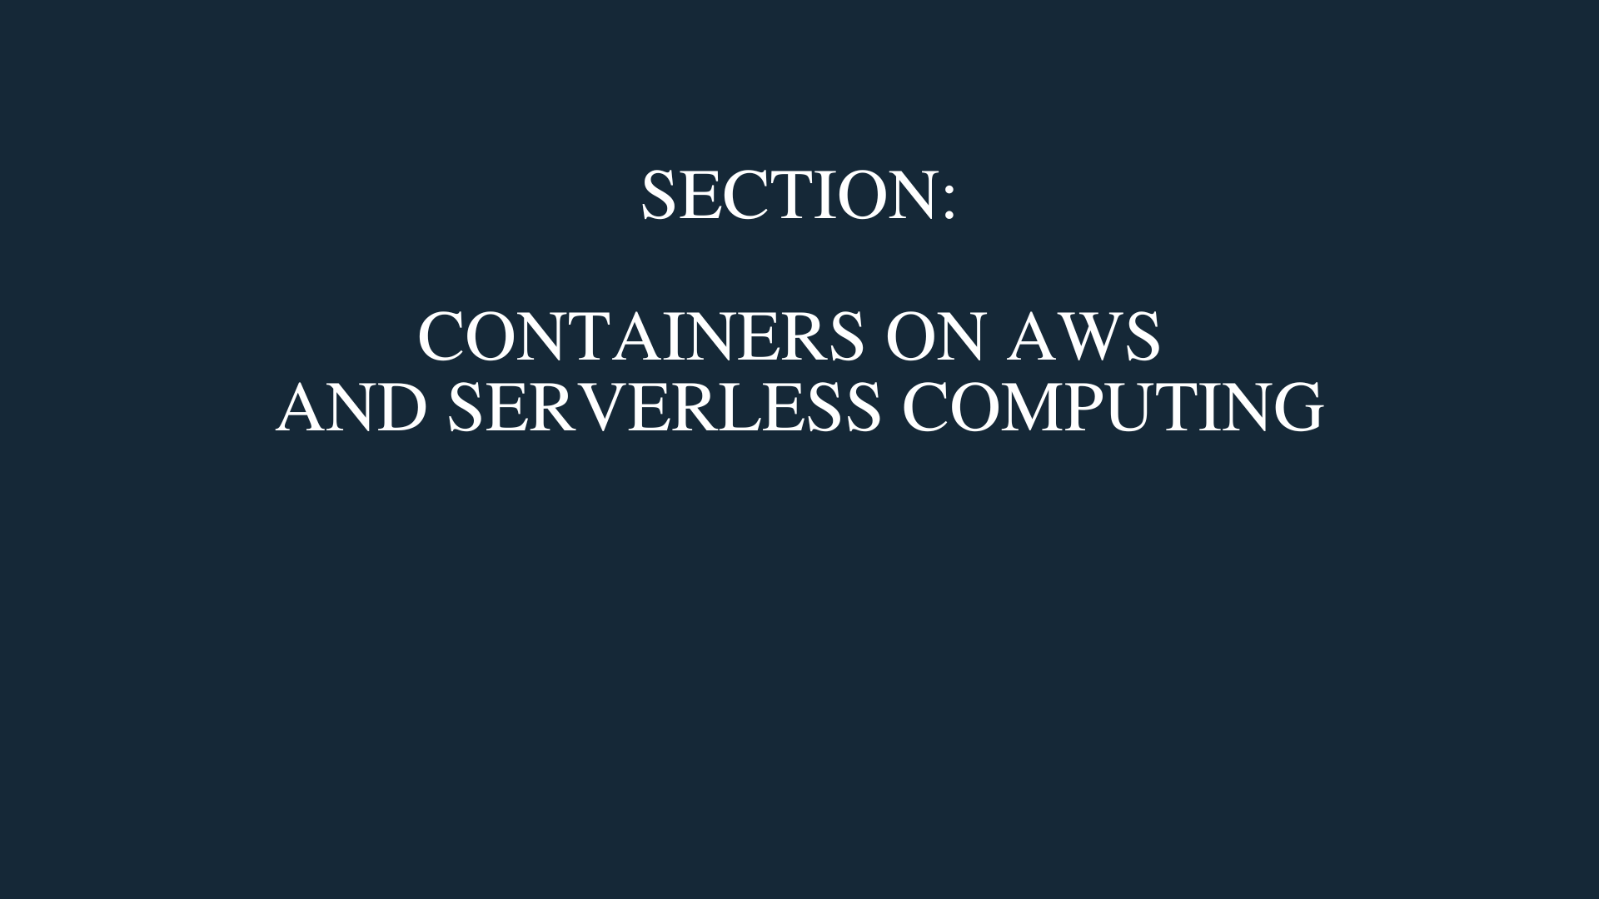
Arno Pretorius

Slide 324
What is docker?
Arno Pretorius

Slide 325

Docker
Docker is a software platform that is used for deploying applications
Applications are packaged into containers and can be easily run on any machine and without any compatibility issues
Arno Pretorius

Slide 326
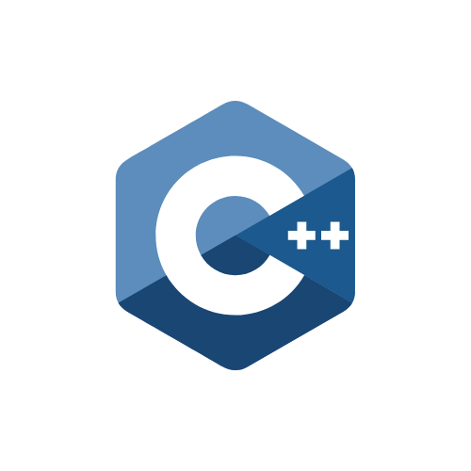
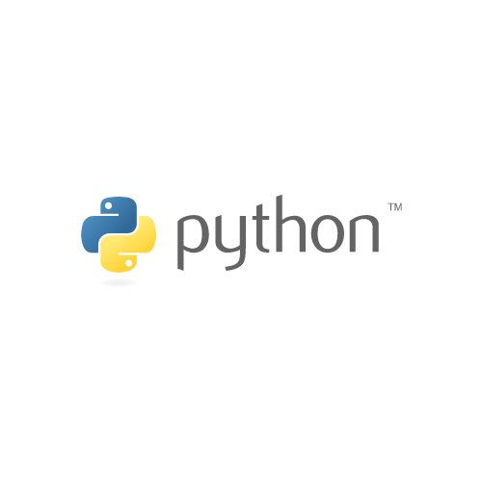
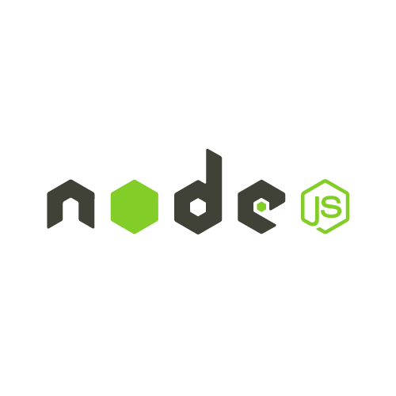
Docker on EC2 - example:
Docker container
Docker container
Docker container
Arno Pretorius

Slide 327


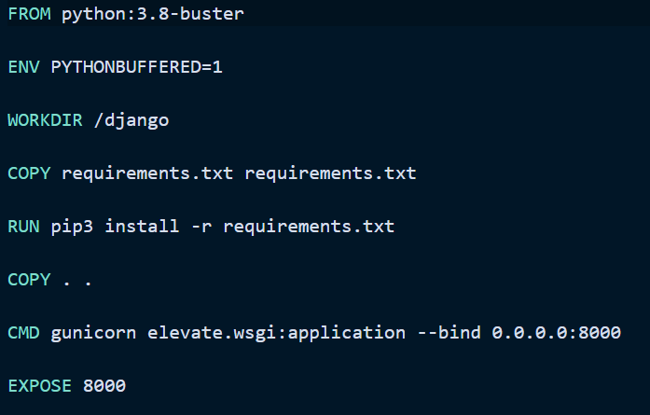
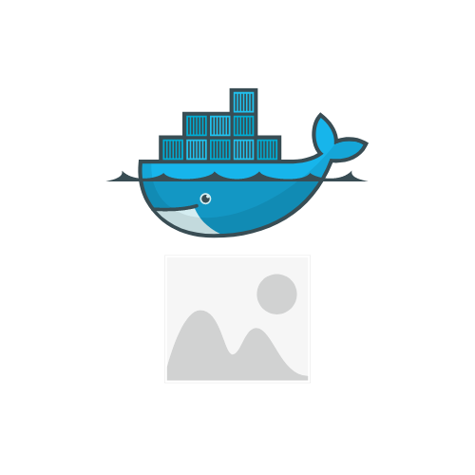
How does docker work?
Create a Docker file
Build our Docker file into a Docker image
Arno Pretorius

Slide 328


How does docker work?
Push our Docker image to a Docker image repository
OR
ECR
Arno Pretorius

Slide 329

How does docker work?
Pull our Docker image from our Docker image repository
Run our Docker image
OR
Docker container
ECR
Arno Pretorius

Slide 330
Managing docker containers on AWS
Arno Pretorius

Slide 331
Amazon Elastic Container Registry
(ECR)
Arno Pretorius

Slide 332
ECR - Overview
A “git-hub” like repository that stores all of your docker images
These images are then available for use by ECS or Fargate
Arno Pretorius

Slide 333
Amazon Elastic Container Service
(ECS)
Arno Pretorius

Slide 334


ECS - Overview
A service which allows you to run your docker containers
With ECS you must manage the cloud infrastructure yourself, which includes the EC2 instances
Arno Pretorius

Slide 335
Running docker containers on ECS
Arno Pretorius

Slide 336

ECS - How it works?
Region
ECS Cluster
ECS Service
Availability Zone
Availability Zone
Task
Task
Task
Task
Task
Task
Arno Pretorius

Slide 337
ECS - Task definition
Our ECS tasks are created from a task definition
This task definition is a type of document which defines our containers characteristics and configurations
Arno Pretorius

Slide 338
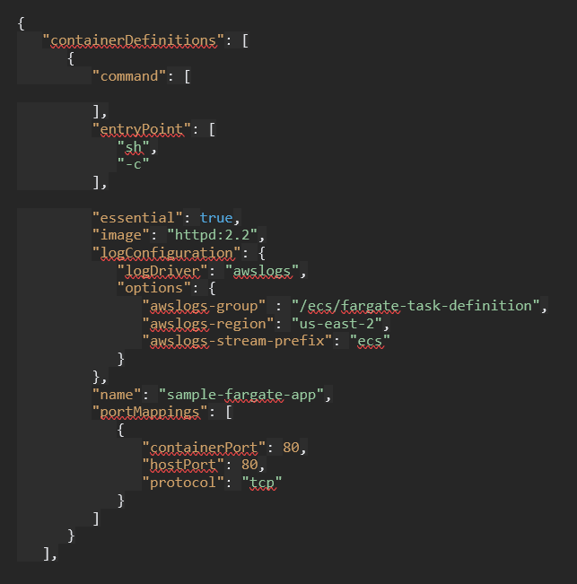
ECS - Task definition: exmaple
Composed of a task definition
Task
Arno Pretorius

Slide 339
ECS - Overview
Launch docker containers with ECS
Arno Pretorius

Slide 340
AWS Fargate
Arno Pretorius

Slide 341

Fargate - Overview
Another service which allows you to run your docker containers
With Fargate you do not need to provision or manage any infrastructure, since it is a serverless service
Arno Pretorius

Slide 342
Amazon Elastic Kubernetes Service
(EKS)
Arno Pretorius

Slide 343


EKS - Overview
Kubernetes is an open-source system for managing, scaling and deploying containerized docker applications
It is the alternative to ECS (Elastic Container Service)
The difference between ECS and Kubernetes is in their API’s
Arno Pretorius

Slide 344
Serverless computing?
Arno Pretorius

Slide 345

Serverless computing?
Serverless computing is a new archetype where users don’t have to worry about managing servers
There are still servers being managed, but in the background, and not by us… Hence, we call this phenomenon as “serverless computing”
= AWS FARGATE
Arno Pretorius

Slide 346
E.g., serverless computing
Arno Pretorius

Slide 347
AWS Lambda
Arno Pretorius

Slide 348
Lambda - Overview
Lambda is an event-driven and serverless computing service that is offered by AWS
Consists of virtual functions, so you do not need to manage servers of any kind
These virtual functions can be run on-demand, just like EC2 instances
Arno Pretorius

Slide 349
Lambda - Overview
Create a Lambda function
Arno Pretorius

Slide 350

Arno Pretorius

Slide 351

Amazon CloudWatch
Arno Pretorius

Slide 352
CloudWatch - Overview
Amazon CloudWatch is a monitoring and management service that provides data and valuable insights pertaining to AWS
Categorize CloudWatch according to some of these resources:
CloudWatch Metrics
CloudWatch Alarms
CloudWatch Logs
Arno Pretorius

Slide 353

CloudWatch - Metrics
CloudWatch provides metrics on our AWS services (EC2, S3, Billing etc.)
With CloudWatch you can monitor specific metrics, such as CPU utilization, NetworkIn, ResourceCount etc.
Arno Pretorius

Slide 354

CloudWatch - Alarms
CloudWatch provides metrics on our AWS services (EC2, S3, Billing etc.)
CloudWatch alarms can be used to trigger notifications of our metrics
Example: A billing alarm warning us that we are close to our designated budget
Arno Pretorius

Slide 355

CloudWatch - Logs
CloudWatch logs is a place where we can centralize all the logs from our AWS services
We can collect logs from a variety of services, such as: ECS, Elastic Beanstalk and Route53
What about EC2?
We would need to run a CloudWatch log agent on our EC2 instances, in order to push the EC2 logs to CloudWatch
Arno Pretorius

Slide 356
CloudWatch - Overview
Explore the CloudWatch section
Analyze CloudWatch metrics
Create a CloudWatch alarm
Utilize CloudWatch logs
Arno Pretorius

Slide 357

AWS CloudTrail
Arno Pretorius

Slide 358

CloudTrail - Overview
CloudTrail is a service that allows you to enable auditing, governance and compliance for your AWS account
You can check all the API calls that have been made on AWS by every user on any service
Arno Pretorius

Slide 359
CloudTrail - Overview
Explore the CloudTrail service
Arno Pretorius

Slide 360

AWS Personal Health Dashboard
Arno Pretorius

Slide 361

Personal Health Dashboard - Overview
The personal health dashboard provides a personalized view on the performance and availability of the AWS services that you are currently using
Arno Pretorius

Slide 362
Personal Health Dashboard - Overview
Explore your personal health dashboard
+ (Bonus)
Explore the service health dashboard
Arno Pretorius

Slide 363
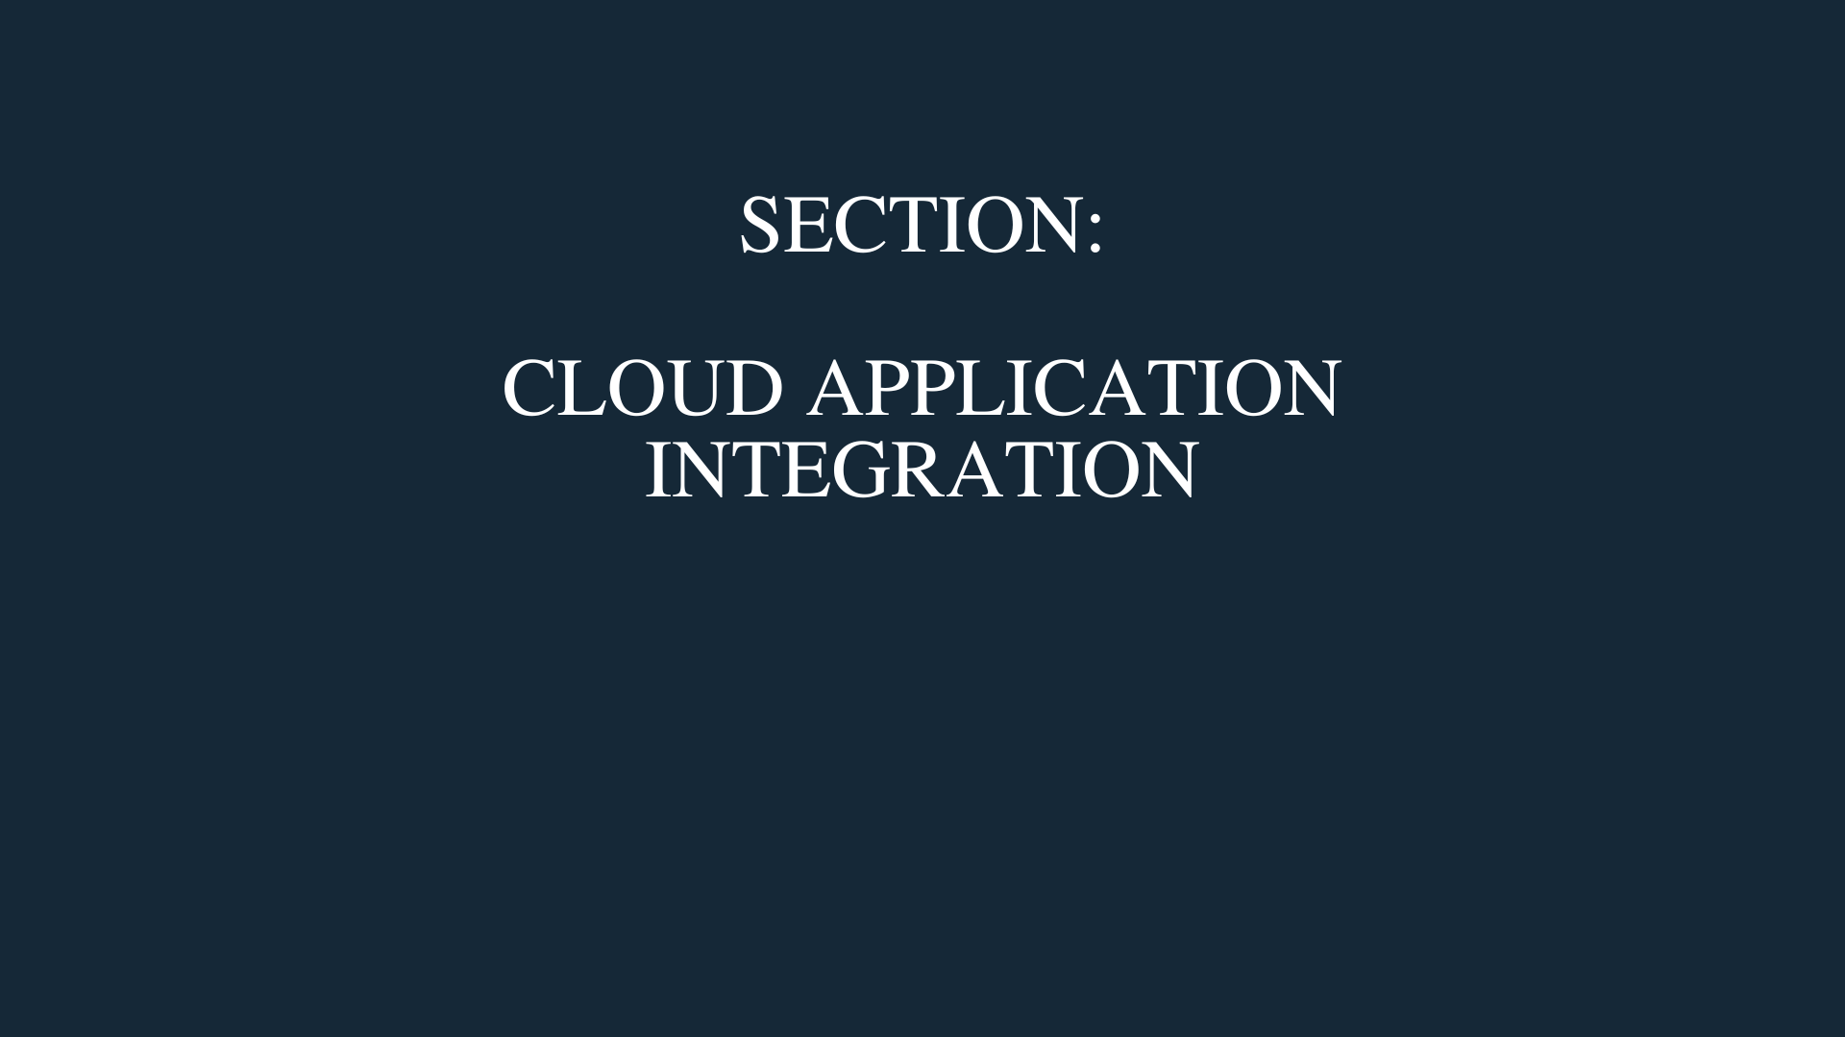
Arno Pretorius

Slide 364


Amazon Simple Queue Service
(SQS)
Arno Pretorius

Slide 365


SQS - How it works?
Producer
Send messages
Poll messages
Consumer
Producer
Consumer
SQS Queue
Producer
Consumer
Arno Pretorius

Slide 366
SQS - Overview
SQS - ‘Simple Queue Service’
It is a fully managed service that is also serverless
Its main purpose is to decouple applications
Messages are retained for 4 days by default, and can be retained for up to 14 days
Once a consumer has a read a message, that message is deleted
Arno Pretorius

Slide 367
SQS - Overview
Create a simple queue using SQS
Arno Pretorius

Slide 368
Amazon Simple Notification Service
(SNS)
Arno Pretorius

Slide 369





SNS - How it works?
Subscribers
Transport protocol
HTTP/HTTPS
Web application
Publisher
Email
Lambda
SMS
Amazon Simple Notification Service (SNS)
Topic
RDS
Arno Pretorius

Slide 370
SNS - Overview
SNS - ‘Simple Notification Service’
Useful for sending messages to several entities
Publishers (event publishers) can only send messages to one SNS topic
An unlimited number of subscribers (event subscribers) can listen to SNS topic notifications
Arno Pretorius

Slide 371
SNS - Overview
Send a notification as a publisher to a subscriber
Arno Pretorius

Slide 372

Arno Pretorius

Slide 373

AWS WAF
Arno Pretorius

Slide 374
WAF - Overview
WAF - ‘Web Application Firewall’
WAF is used to protect our websites/ web applications against web exploits
This ‘protection’ is carried out by monitoring, filtering and blocking HTTP/HTTPS [layer 7] traffic that is travelling towards our application
Define a Web Access Control List (ACL) to control and inspect web requests by a set of rules
Arno Pretorius

Slide 375
WAF - Overview
Explore AWS WAF
Arno Pretorius

Slide 376

AWS Shield
Arno Pretorius

Slide 377
Shield - Overview
AWS Shield is a managed Distributed Denial of Service (DDoS) protection service that protects our applications that are running on AWS
AWS shield comes with standard and advanced protection:
AWS shield - standard is automatically enabled for AWS users and helps to prevent reflection attacks, SYN/UDP floods and DDoS attacks
AWS shield - advanced is a paid service that protects our applications from many web exploits, it also provides us with 24/7 access to the AWS DDoS response team
Arno Pretorius

Slide 378
What is a DDoS attack?
A DDoS attack, otherwise known as a Distributed Denial of Service attack is a cybercrime that involves a malicious user flooding a server with an excess amount of internet traffic to prevent users from accessing that website
Arno Pretorius

Slide 379




How is a DDoS attack carried out?
Attacker
Handler
Application server
Zombies
Arno Pretorius

Slide 380
Shield - Overview
Explore AWS Shield
Arno Pretorius

Slide 381
Penetration testing
Arno Pretorius

Slide 382

Penetration testing
As an AWS user you are allowed to perform penetration tests on several of your AWS services (I.e., EC2 instances, RDS instances, CloudFront etc.)
While AWS does allow you to perform penetration testing there are rules for what you are allowed and not allowed to do
For more information:
https://aws.amazon.com/security/penetration-testing/
Arno Pretorius

Slide 383
Data encryption
Arno Pretorius

Slide 384

Understanding data encryption
Data is encrypted in-transit
Bucket 1
Bucket 2
Data is encrypted at rest in an S3 bucket
We can use encryption keys to protect our data in both states (at rest + in-transit)
Arno Pretorius

Slide 385

AWS Key Management Service
(KMS)
Arno Pretorius

Slide 386
KMS - Overview
AWS KMS - ‘Key Management Service’
KMS uses hardware security modules to protect and manage our keys for us
KMS manages the software that is used for encryption
It can also be integrated with AWS CloudTrail to provide use with a usage report on the usage of our keys - helpful for compliance
Arno Pretorius

Slide 387

AWS CloudHSM
Arno Pretorius

Slide 388
CloudHSM - Overview
CloudHSM provisions encryption hardware
AWS provides a HSM (hardware security module), which allows us to generate, store and manage cryptographic keys
The users (us) will manage their own encryption keys
Arno Pretorius

Slide 389
KMS + CloudHSM - Overview
Identify the process of creating an encryption key in AWS
Arno Pretorius

Slide 390

Arno Pretorius

Slide 391
What is analytics?
Arno Pretorius

Slide 392

What is analytics?
Analytics can be defined as the systematic process of discovering, interpreting and communicating unique patterns that are present in data
Arno Pretorius

Slide 393

Amazon Athena
Arno Pretorius

Slide 394
Athena - Overview
Athena is a serverless service that is used to analyze data in Amazon S3 buckets
It uses SQL to query the files in the S3 buckets
Arno Pretorius

Slide 395
Athena - How does it work?
bucket1
User uploads files to a bucket
Query the data in bucket1 and then analyze it
Amazon Athena
Arno Pretorius

Slide 396

Amazon EMR
Arno Pretorius

Slide 397
EMR - Overview
EMR is a tool that is used for analysis and big data processing
In the past it was commonly referred to as “Elastic MapReduce”
EMR is based on Apache Hadoop - which is a Java-based framework that is used for processing huge data sets
Use cases:
- Data analysis for web indexing, financial analysis and bio-informatics
Arno Pretorius

Slide 398

Amazon QuickSight
Arno Pretorius

Slide 399

QuickSight - Overview
Quicksight is another serverless tool that uses business intelligence (BI) to deliver easily understandable insights to users
It can further be utilized to create interactive dashboards highlighting these insights
Use case:
- View tweets with negative sentiments
Arno Pretorius

Slide 400

Amazon RedShift
Arno Pretorius

Slide 401
RedShift - Overview
Redshift uses SQL to analyze data across data lakes, data warehouses and even operational databases
It is therefore used for OLAP (Online Analytical Processing)
Has the capacity to analyze data and run analytical queries
Arno Pretorius

Slide 402

AWS Glue
Arno Pretorius

Slide 403

Glue - Overview
Glue is a serverless service that is used to obtain and combine data for analytics
It is known as a managed ETL service, which translates as - Extract, Transform and Load
Arno Pretorius

Slide 404
AWS Lake Formation
Arno Pretorius

Slide 405

Lake Formation - Overview
Lake Formation is a service that allows you to store your data in a “secure lake”
This “secure lake” acts as a kind of repository for storing your data
Your stored data can also be prepared for analysis by Athena
Arno Pretorius

Slide 406
AWS Data Exchange
Arno Pretorius

Slide 407

Data Exchange - Overview
Data Exchange is an AWS service that provides a simple way for users to subscribe to and utilize third-party data in the cloud
Arno Pretorius

Slide 408
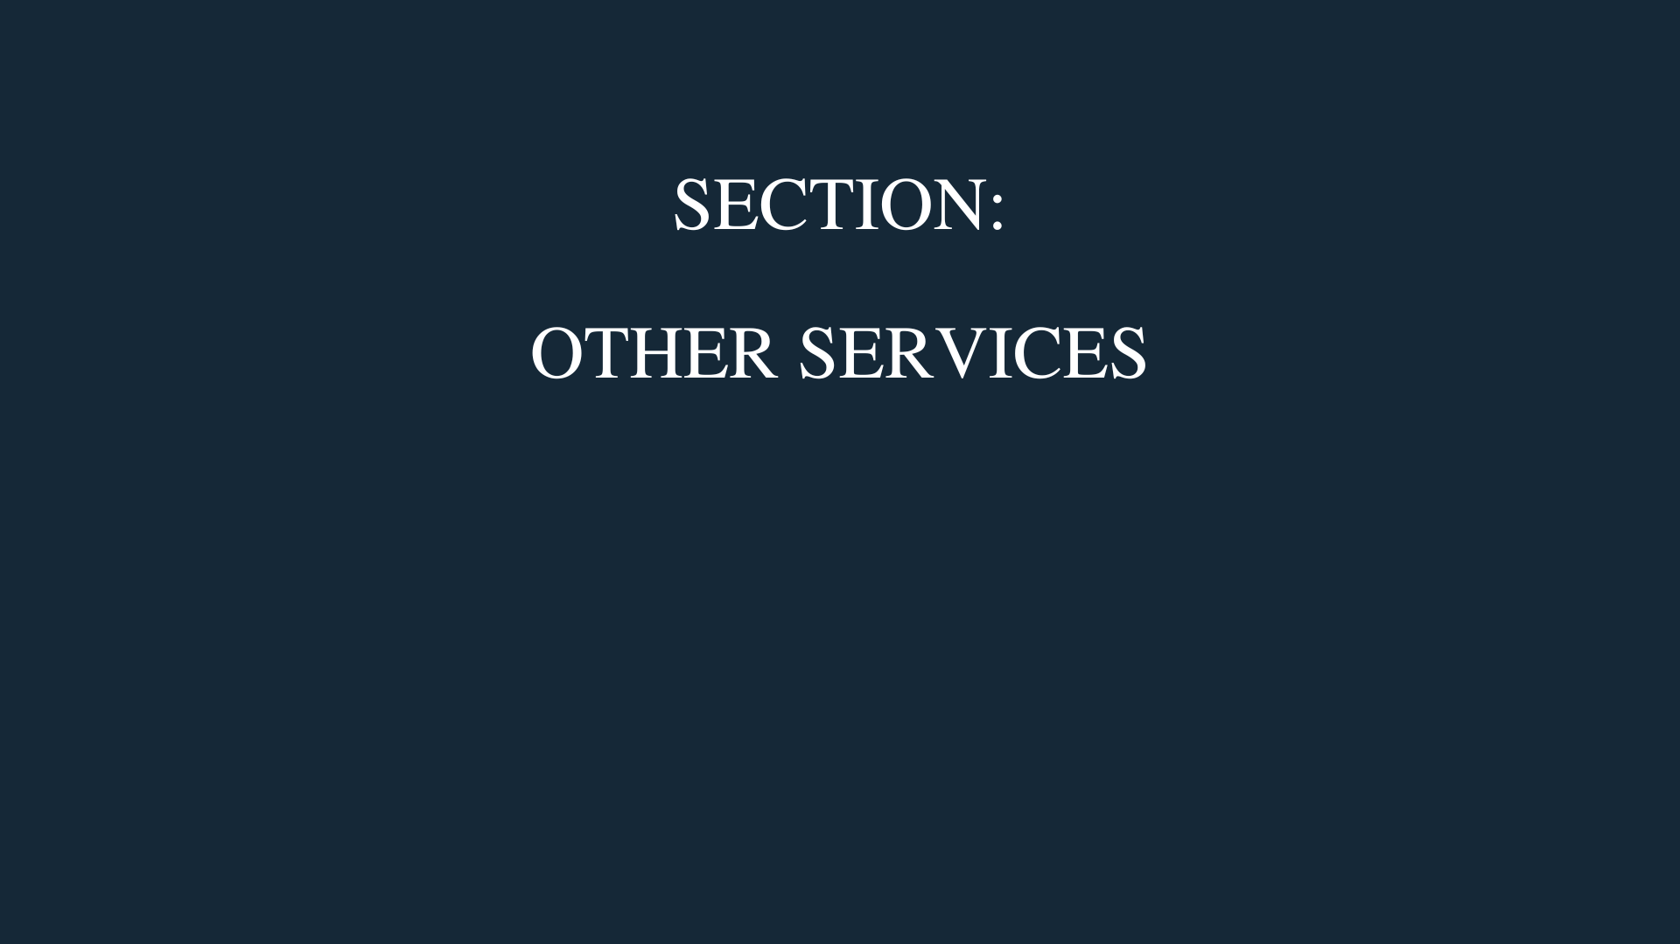
Arno Pretorius

Slide 409

Amazon LightSail
Arno Pretorius

Slide 410
LightSail - Overview
LightSail allows users to deploy their own virtual private servers and databases
Made for people with little to no cloud experience
Generally used for small applications and for testing
Arno Pretorius

Slide 411
LightSail - Overview
Explore the LightSail service
Arno Pretorius

Slide 412

AWS Secrets Manager
Arno Pretorius

Slide 413
Secrets Manager - Overview
AWS Secrets Manager is used to help protect secrets that are needed to access our applications
It can be integrated with many AWS services, such as RDS
All secrets are encrypted with AWS KMS
Arno Pretorius

Slide 414
Secrets Manager - Overview
Store a new secret
Arno Pretorius

Slide 415

Amazon Rekognition
Arno Pretorius

Slide 416
Rekognition - Overview
Rekognition is a machine learning (ML) based service that you can use to identify objects, text and people in images and videos
Use-cases:
Text detection
Facial detection and verification
Labeling
Arno Pretorius

Slide 417
Rekognition - Overview
Explore the Rekognition service
Arno Pretorius

Slide 418

Arno Pretorius

Slide 419

Arno Pretorius

